Slide 1
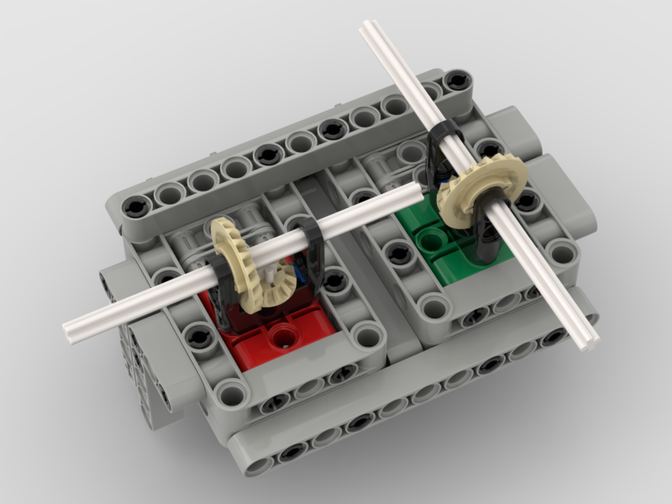
Base Attachment
See how on the green side (which is the right side of the robot in the picture), we have an axle that sticks out the front? And on the red side (the left side of the robot in the picture), the axle sticks out to the left? YOU decide which way you want your axles. You could have both axles sticking out the front. Or you could have both sticking out the sides. Or you could have only one axle. There is even an option to have the axles pointing straight up (not pictured here, but the instructions will show you what to do). You can switch the red and green. It's all up to you. Before you go any further, think about where you want your axles when you are done. Talk to a coach if you aren't sure.
Forward

Slide 2
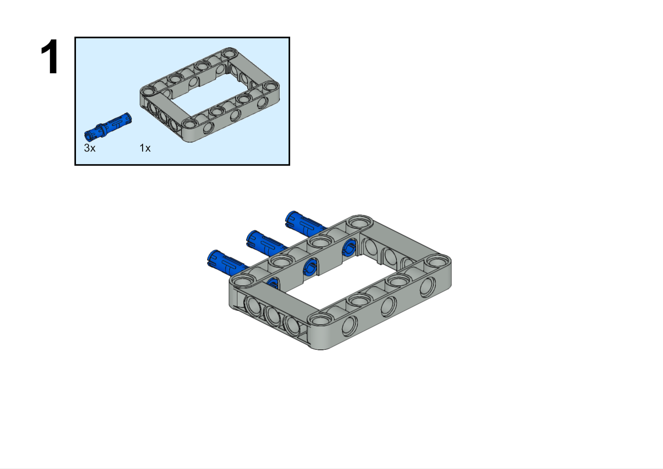
These are the "Build Plate" build instructions. All of your attachments will start with this. It is then up to you to figure out what else you need on your attachment. Everything will attach to this. You will not be able to "pin attach" anything directly to the robot, with one rare exception.
The large piece is called a "frame". It is five by seven studs. The blue peg is three studs long. You will be using these pieces a lot with your robot. You should have these pieces in your colored bin of parts, but we have more in storage if you need them.

Slide 3
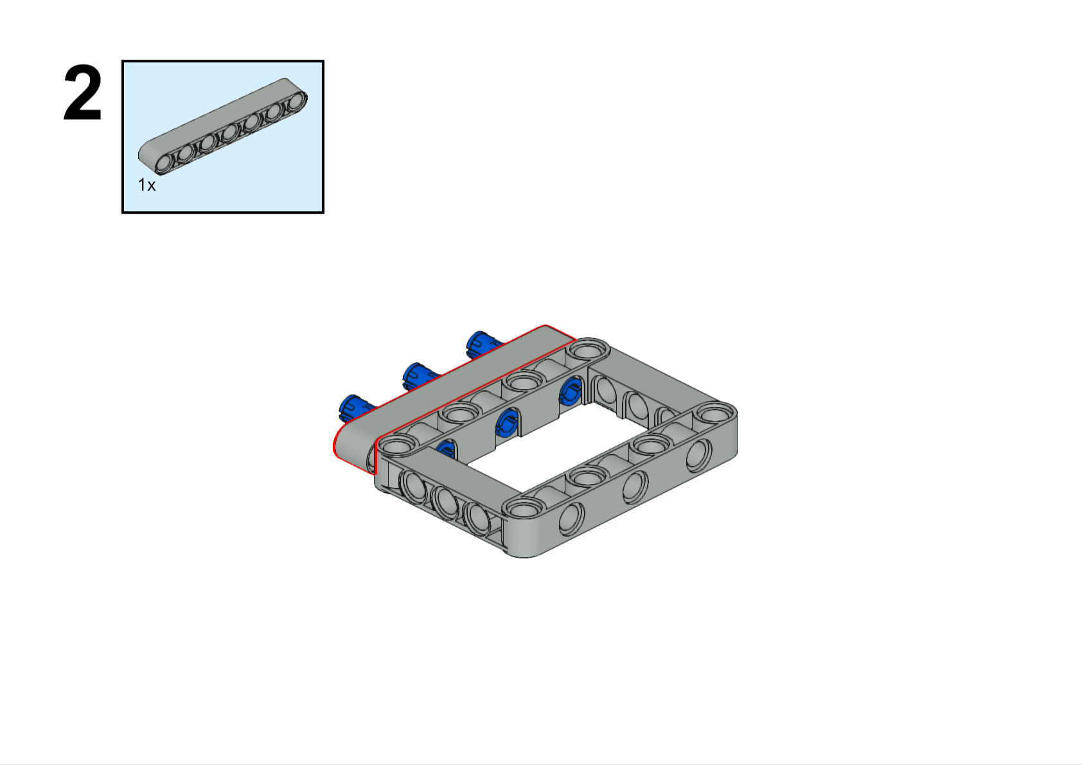
This is called a "beam", but Lego usually calls them "liftarms". You can get this piece from your colored bin of parts. They come in sizes from three to fifteen studs in length, but all odd numbers. However, there is one even numbered beam. Do you know which one? Hint: this is sort of a trick question. By the way, we also have "beams" that are one stud long. We call them "one-beams"
7L
This beam is seven studs long. We call it a seven-beam.

Slide 4
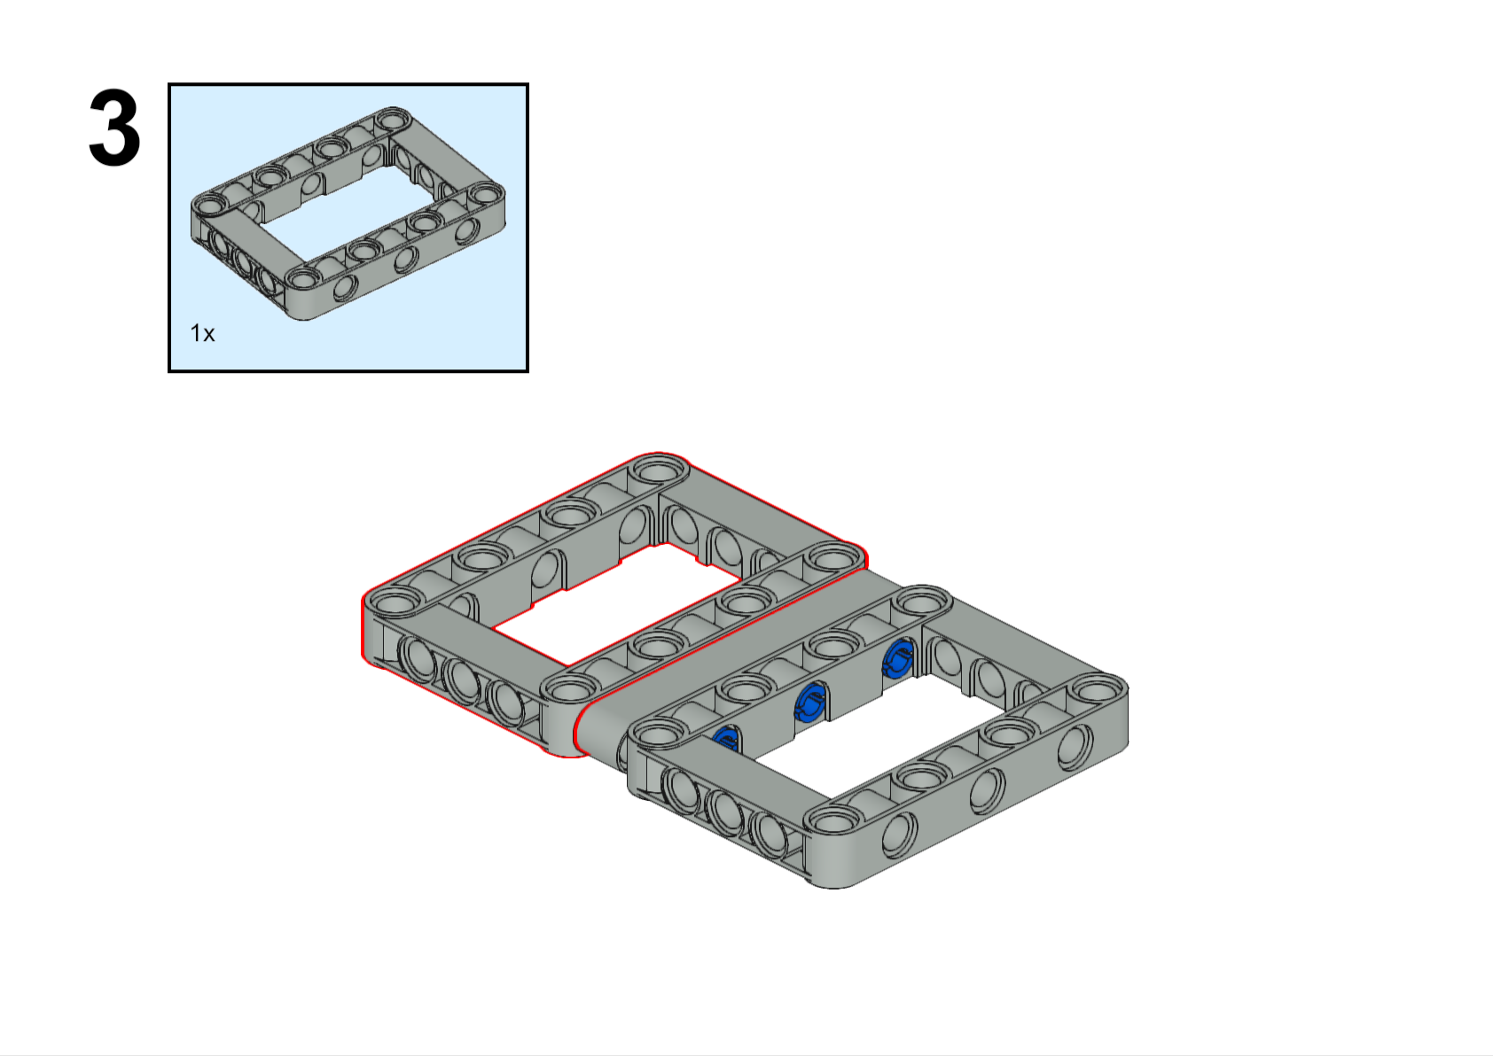

Slide 5
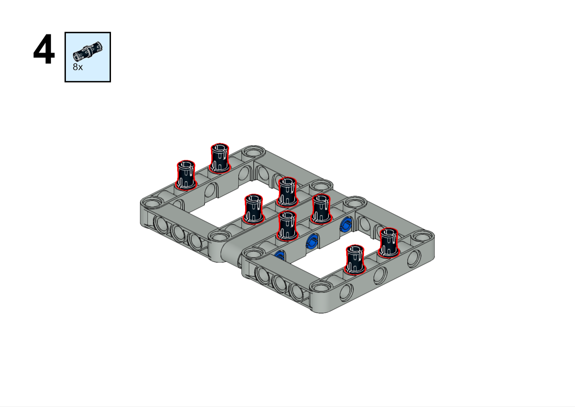
Ahhh.. the black peg. We have over six thousand of them in bins but there is probably one on the floor right now!

Slide 6
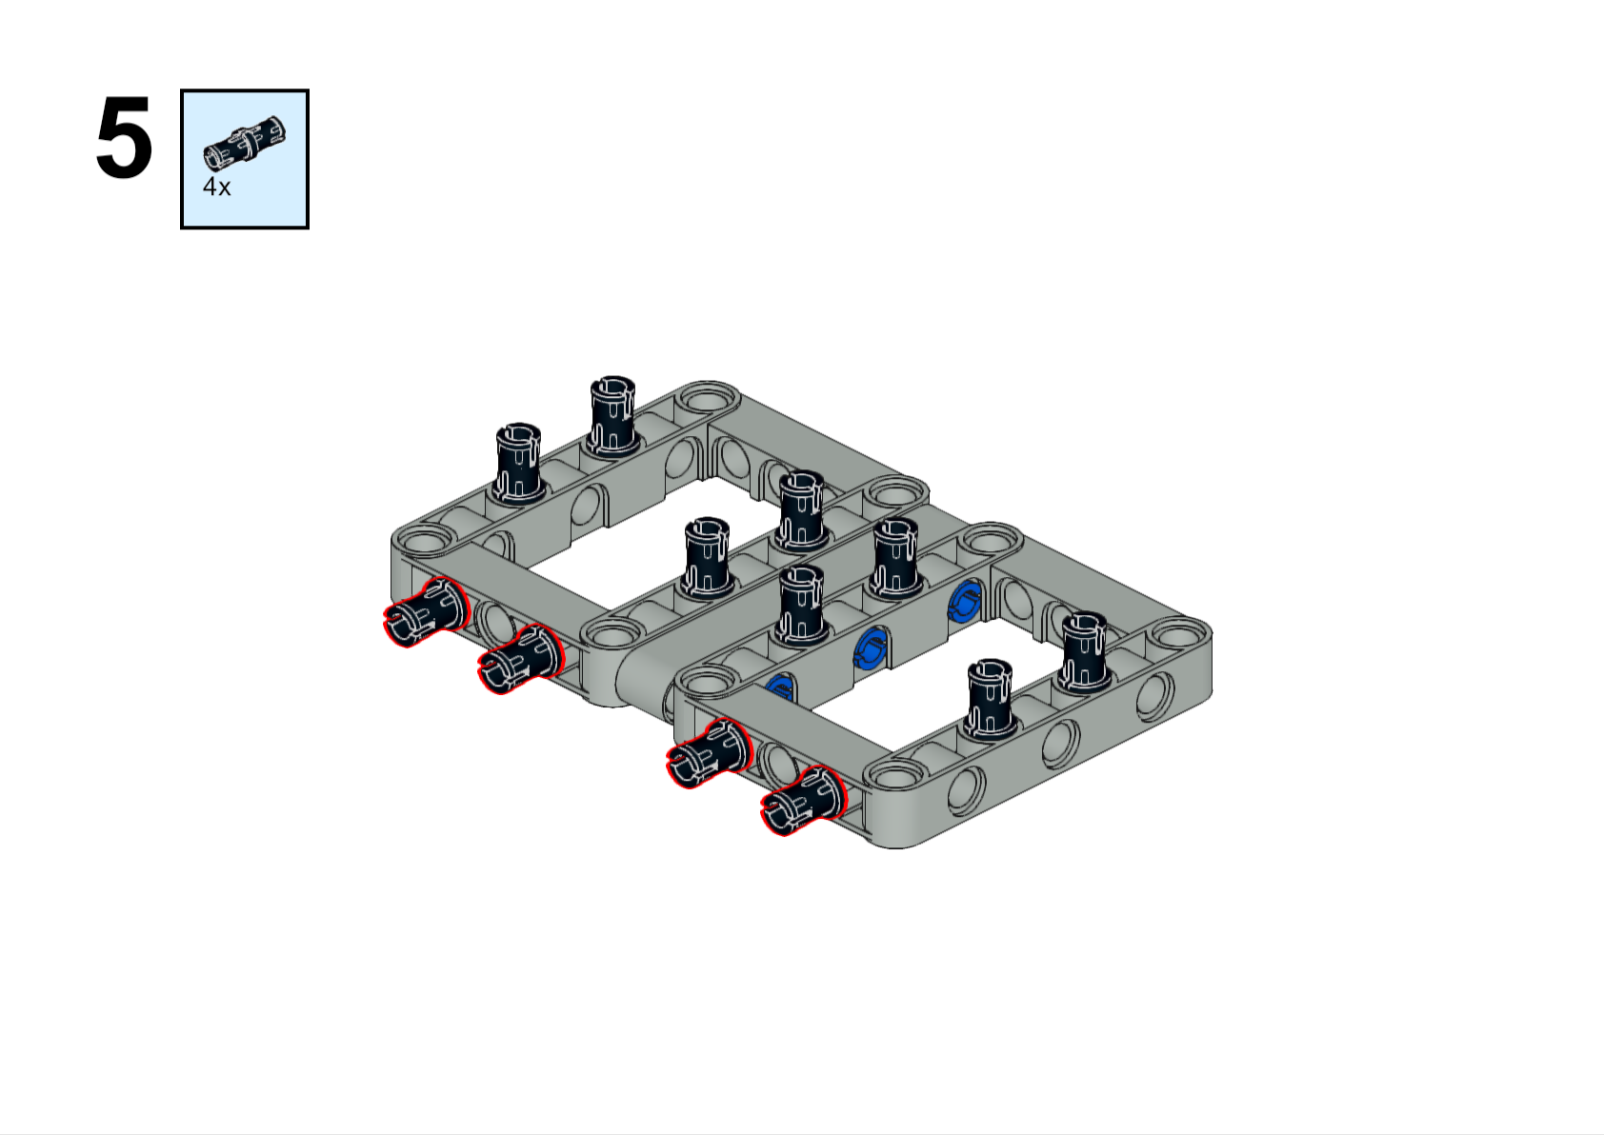
Forward

Slide 7
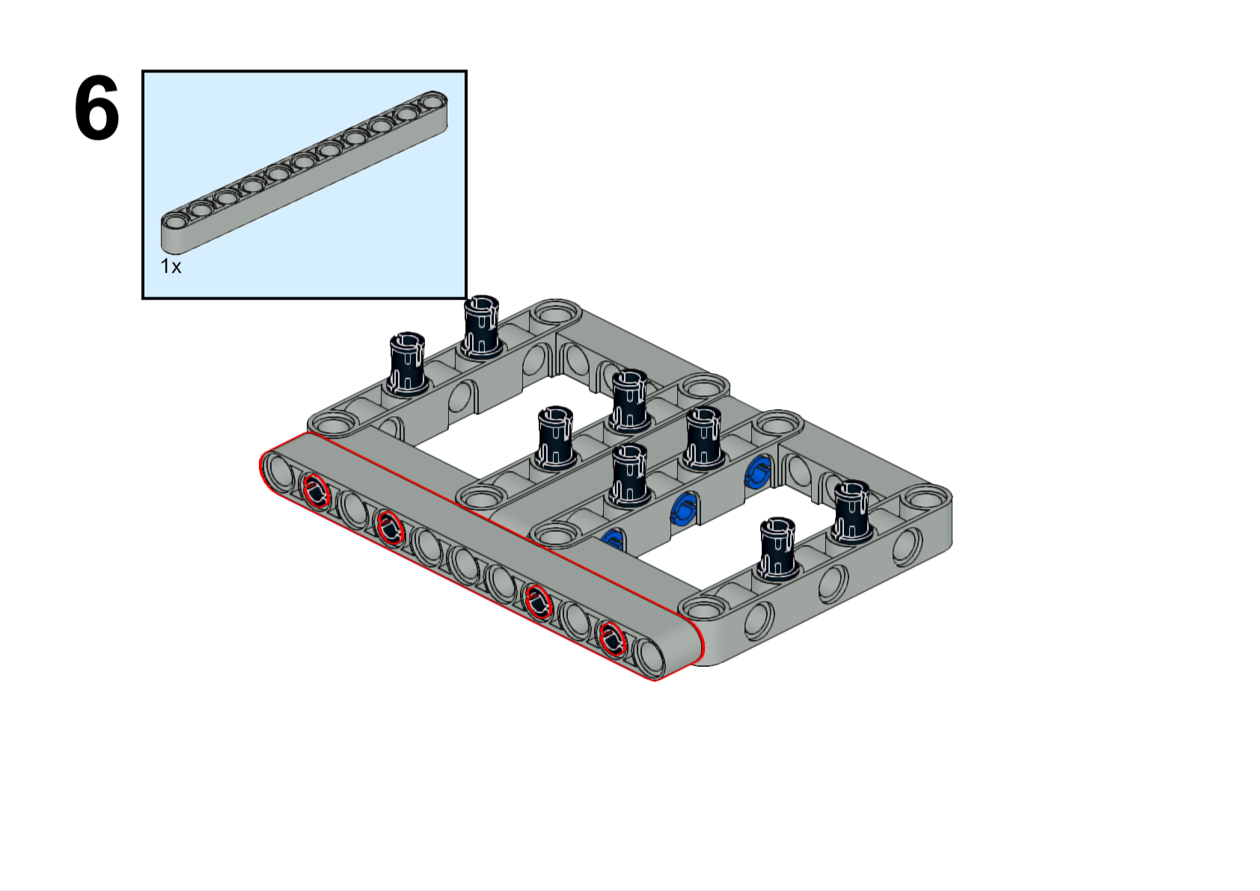
11L
Forward

Slide 8
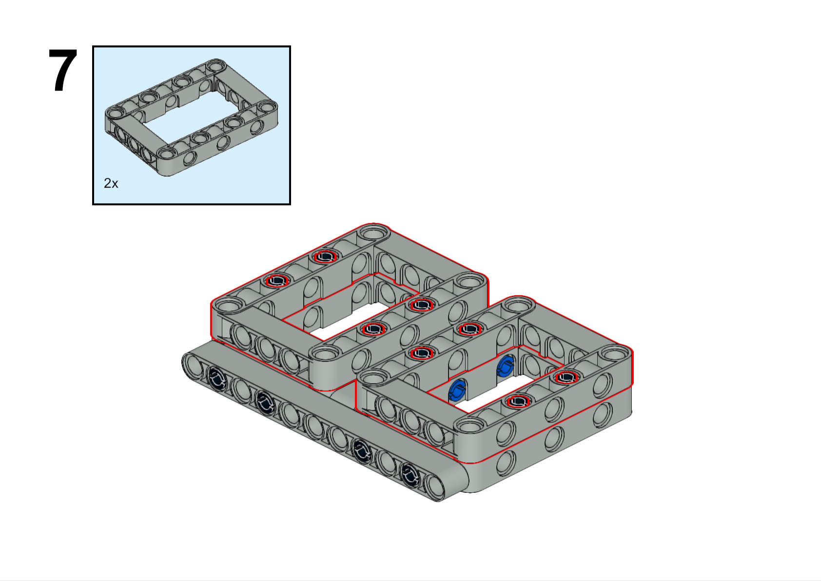
Forward

Slide 9
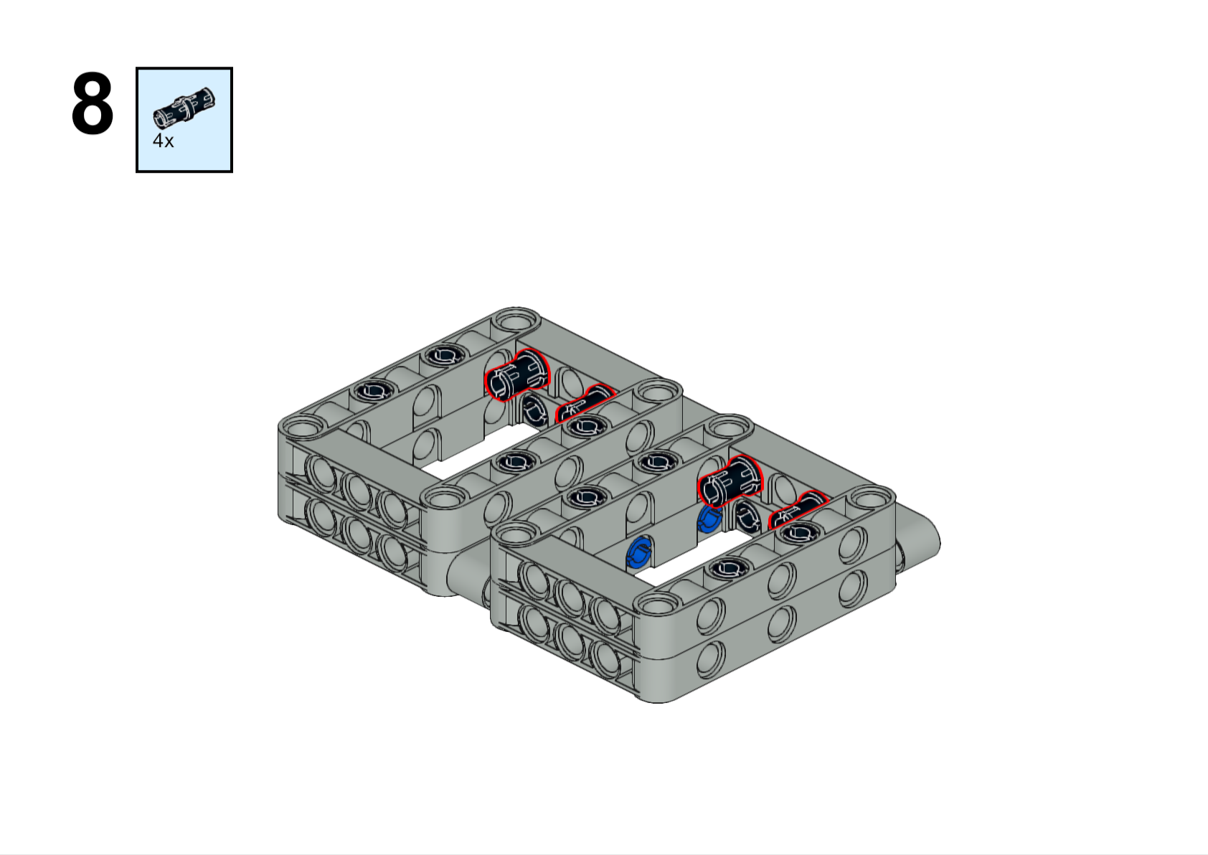

Forward

Slide 10
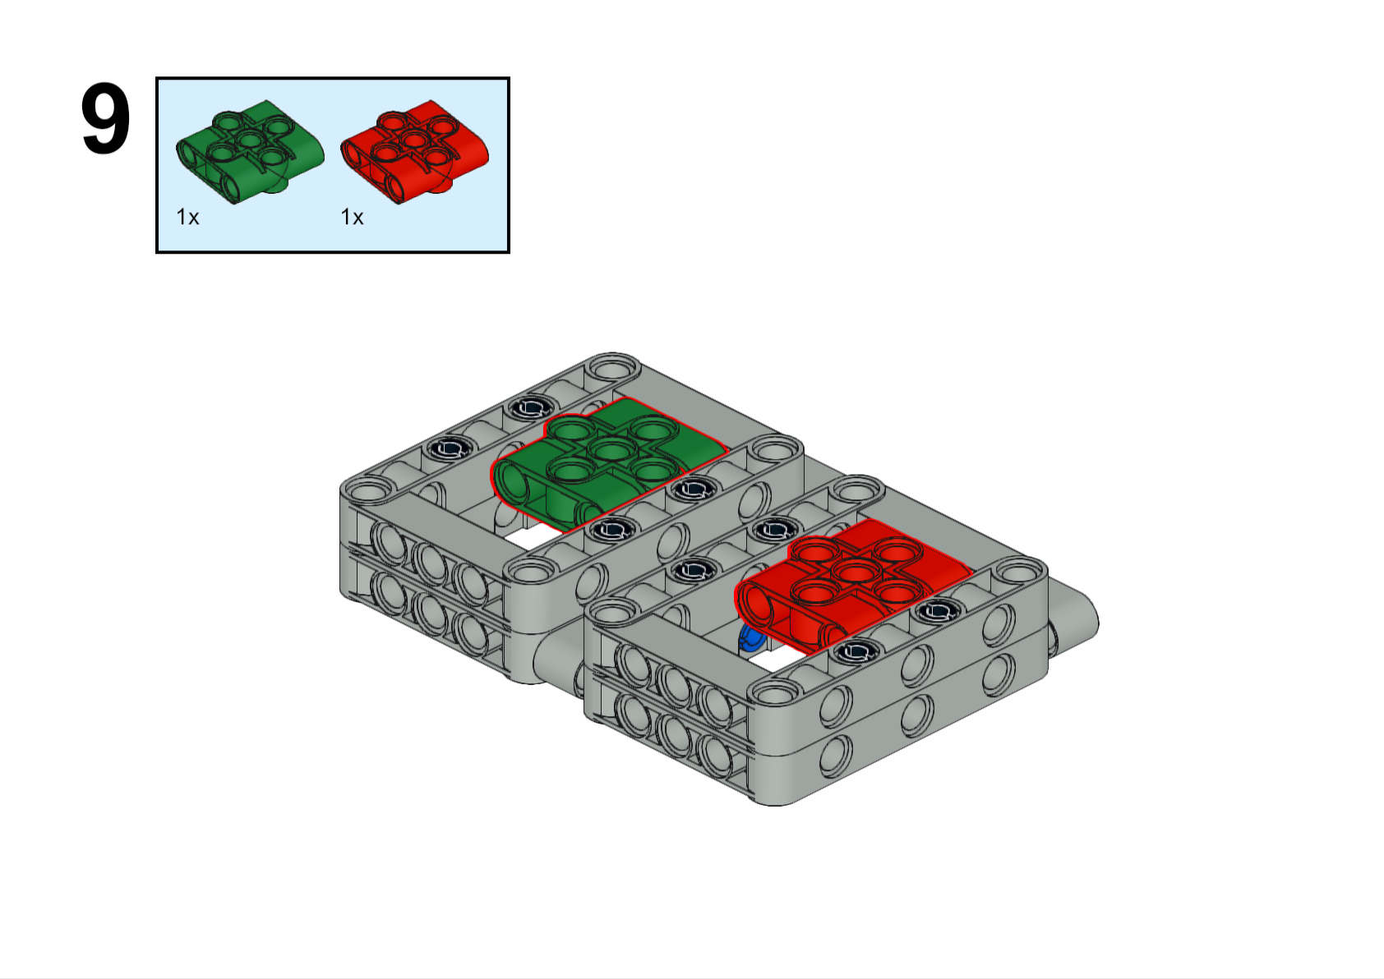
Colors don't matter here. The red and green is just to make it easier to follow the instructions. These pieces are often called "waffles". Can you guess why?
Right side
Left side
Forward

Slide 11
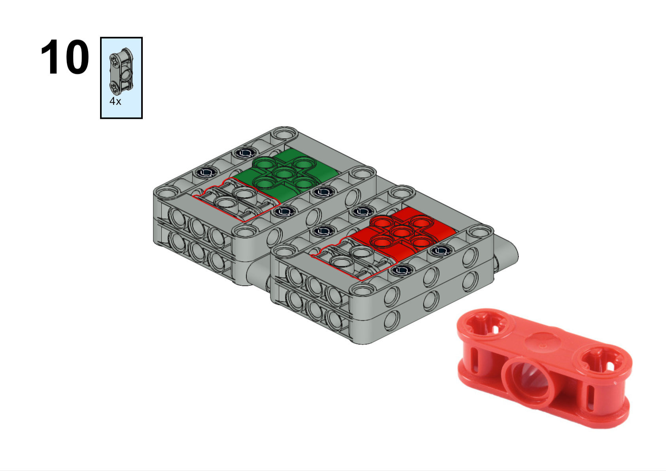
These won’t stay in place until you complete the next step. So just get the pieces you need for now.
This is a better picture of the piece you are looking for

Slide 12
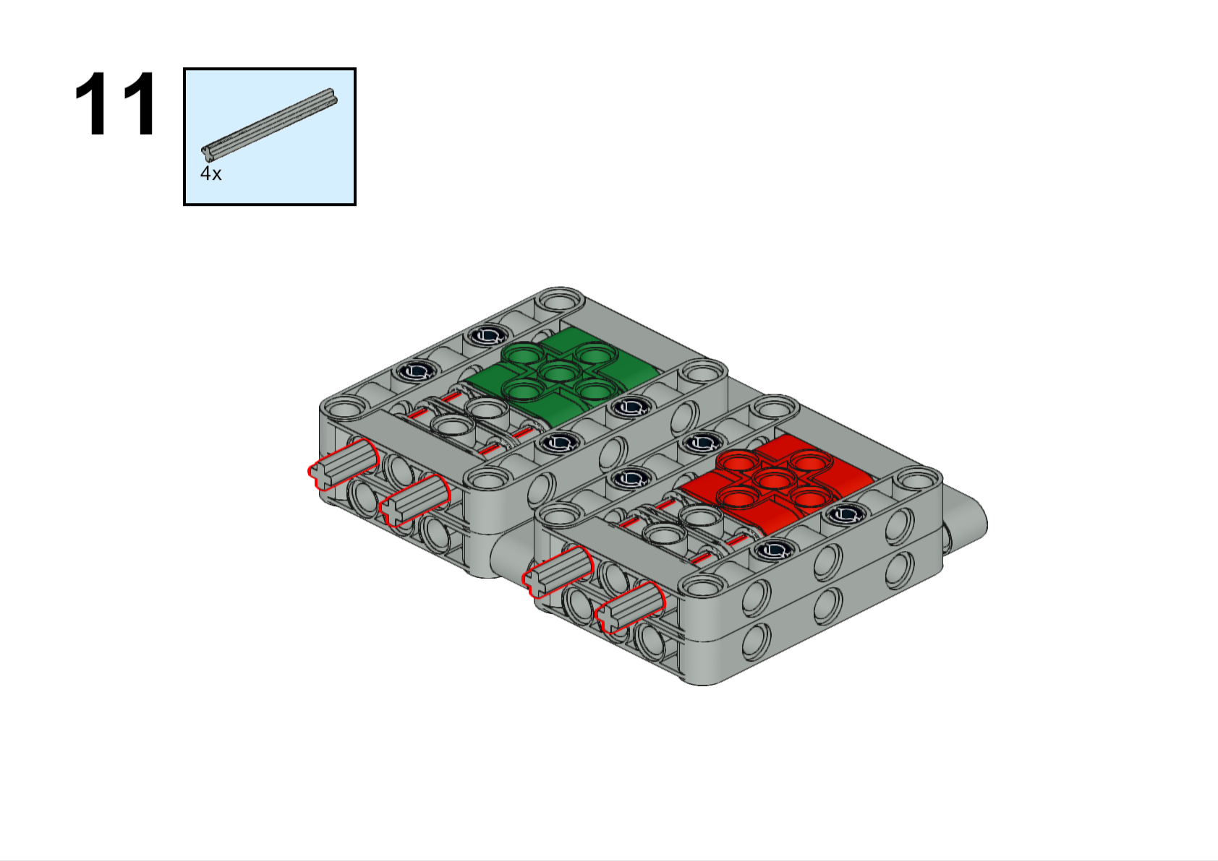
This piece is called an "axle". We normally use them to connect rotating pieces, but in this case we are using them for structure and support. Axles come in sizes from two to twelve studs in length, plus some other really long ones. We have all kinds of connectors to make any size or shape you need.
5L
Axles will stick out here just like the picture shows

Slide 13
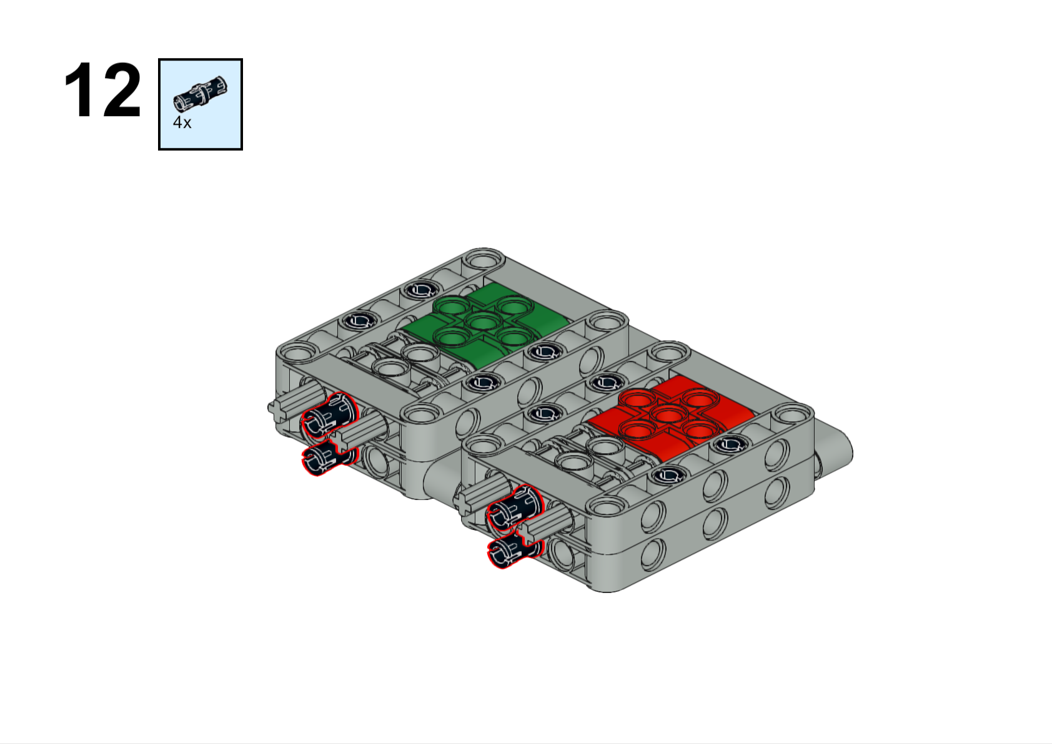

Slide 14
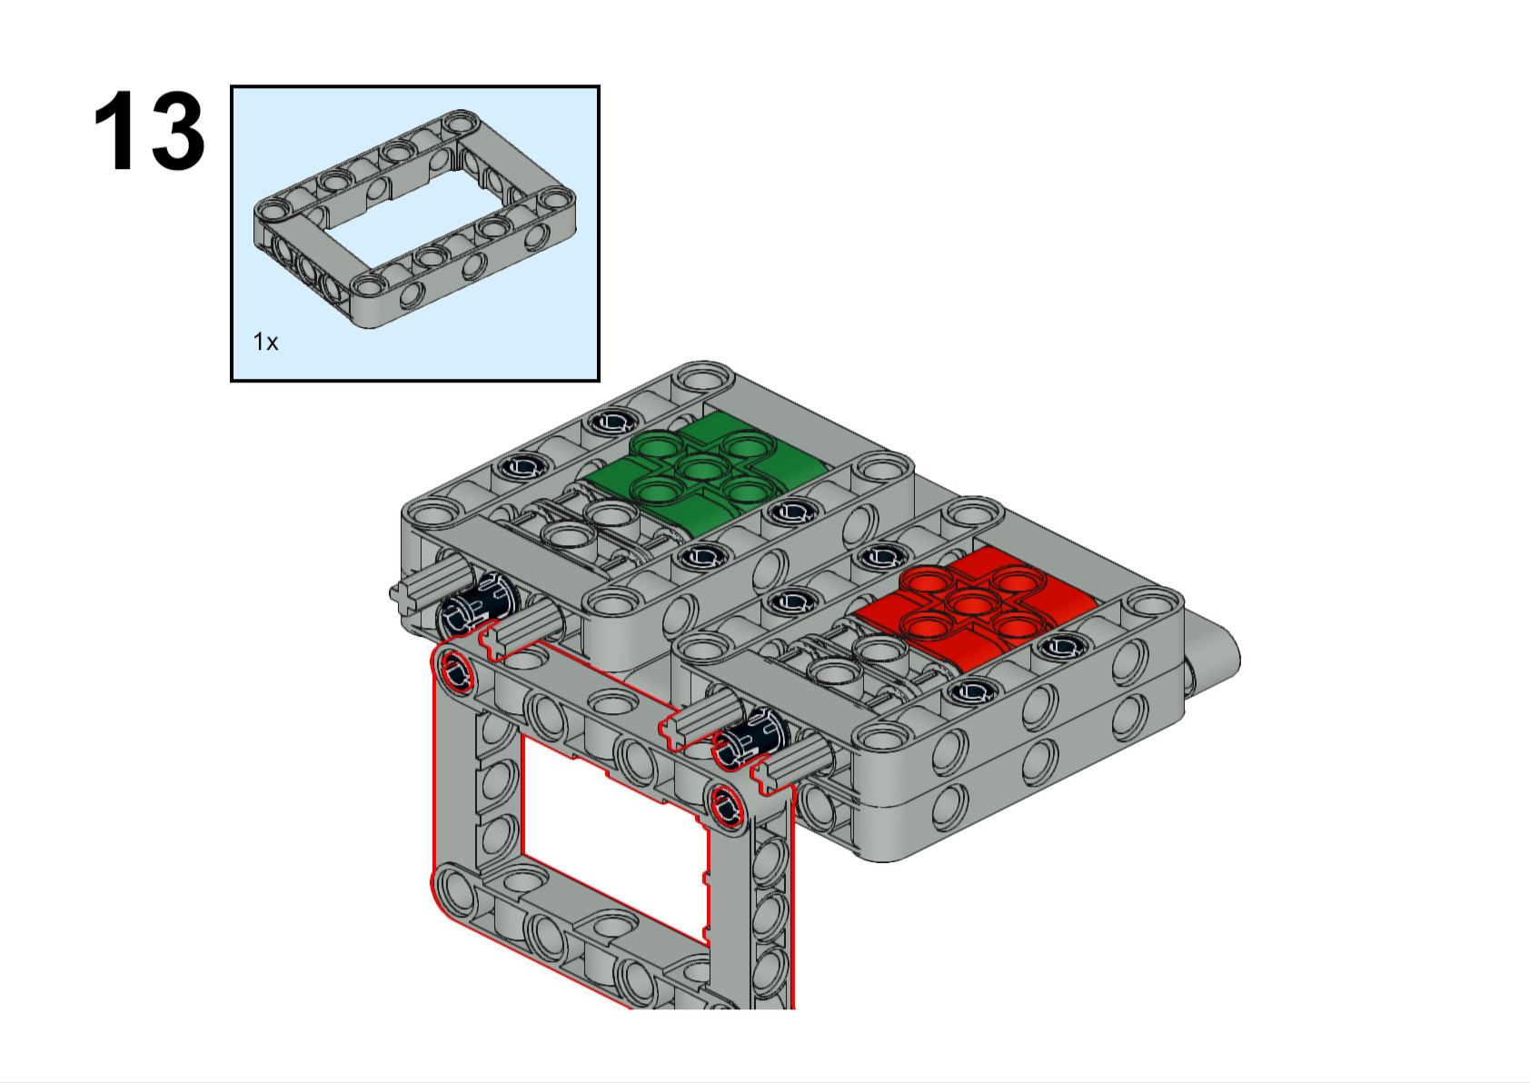
This frame is very important, but you may not understand why until next year!

Slide 15
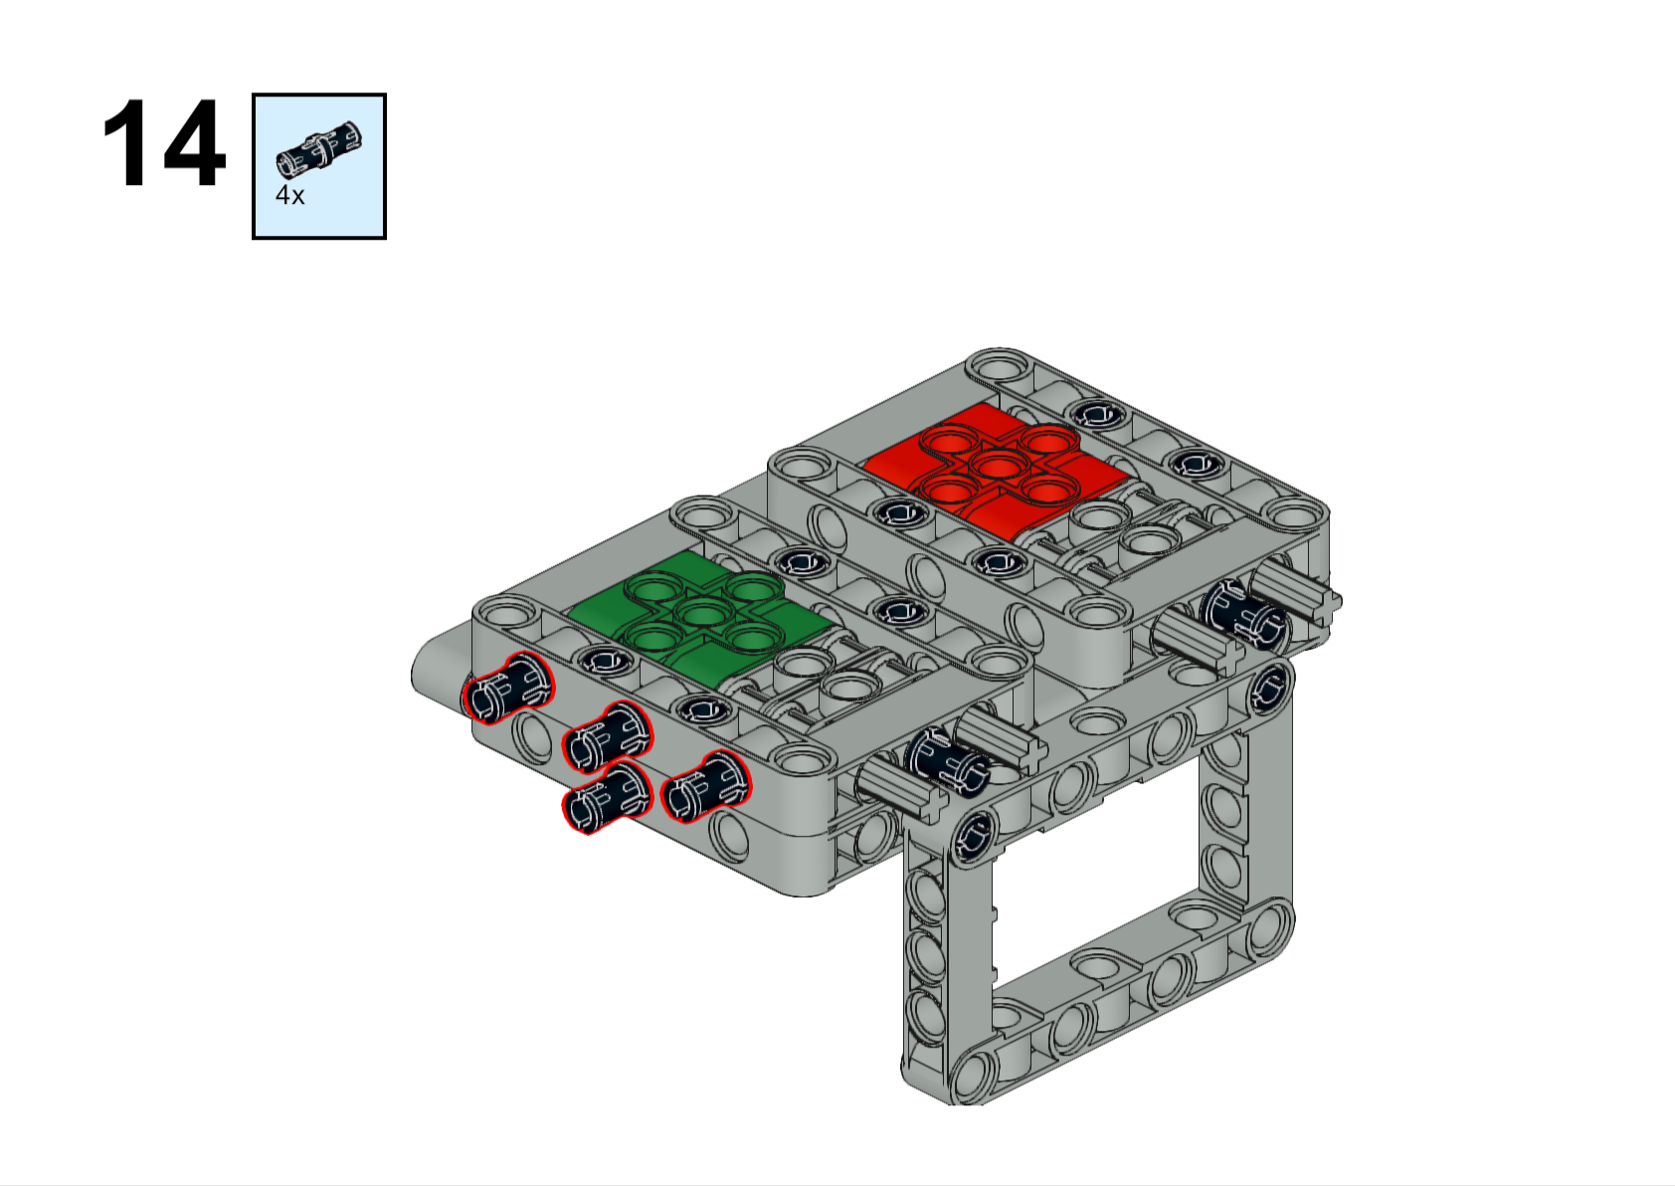
Left side
Right side
Forward

Slide 16
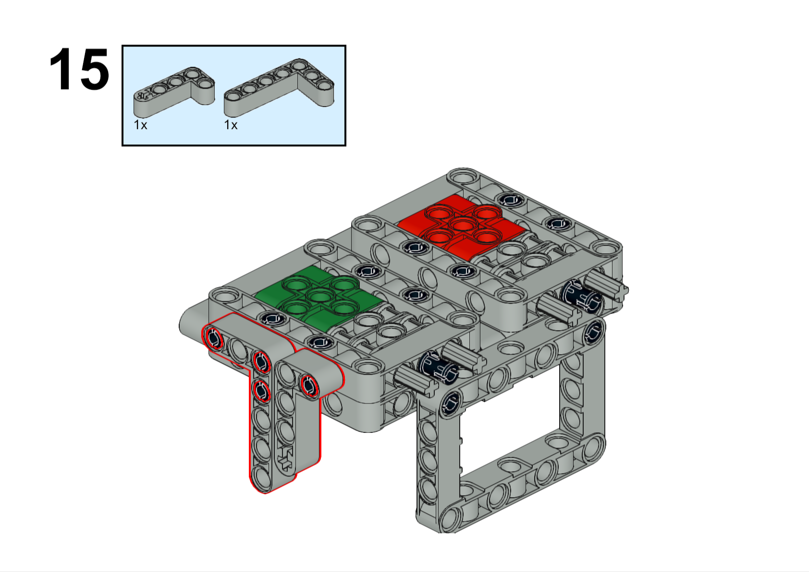

Slide 17
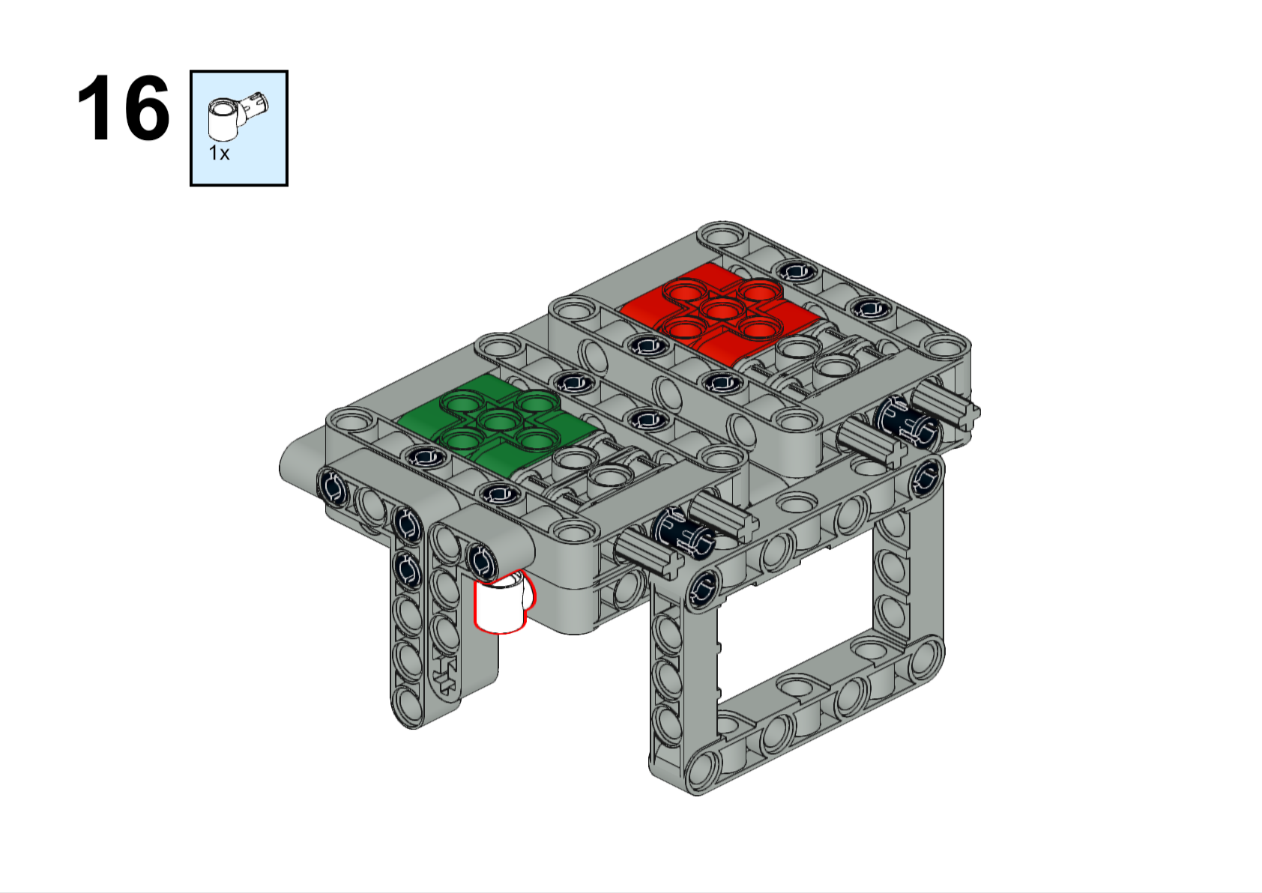
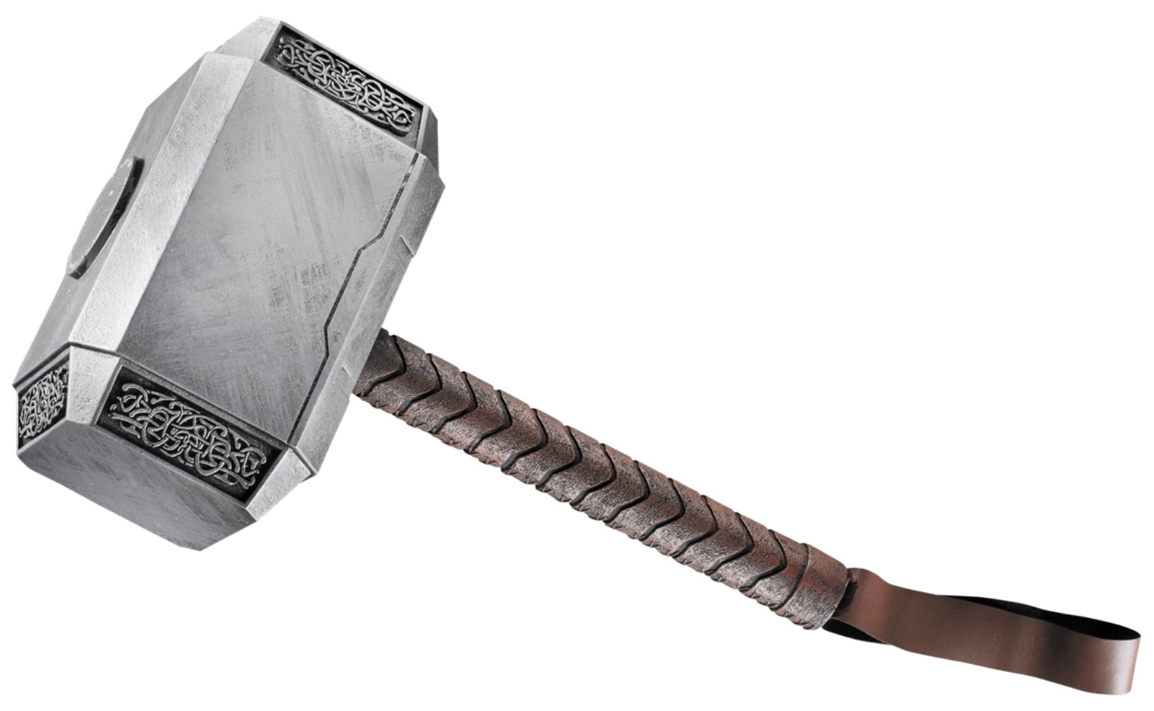
We call this piece a “hammer”.

Slide 18
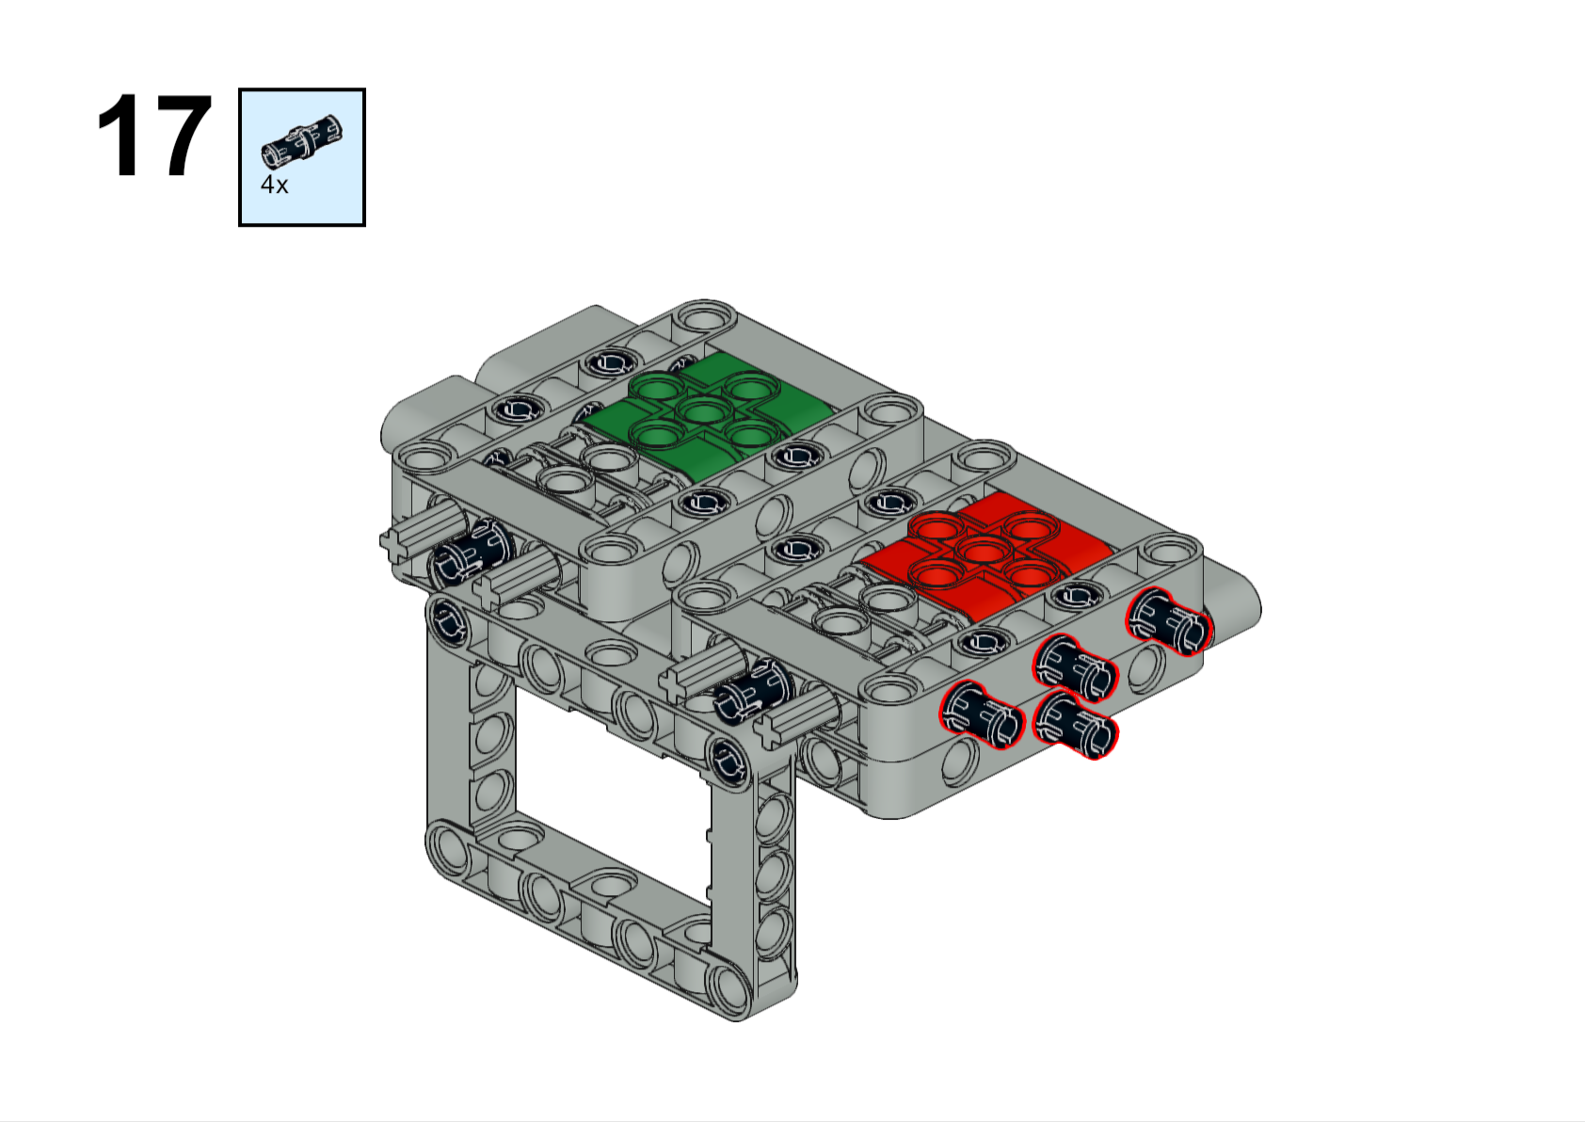
Right side
Left side
Forward

Slide 19
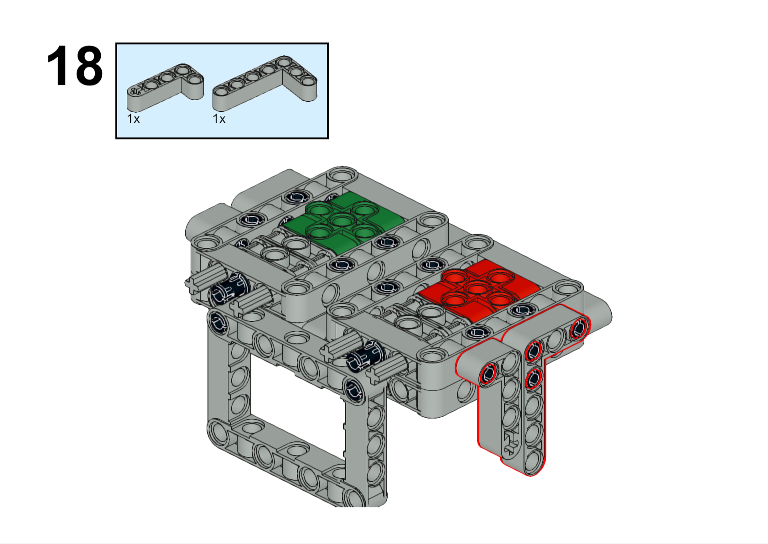
Forward

Slide 20
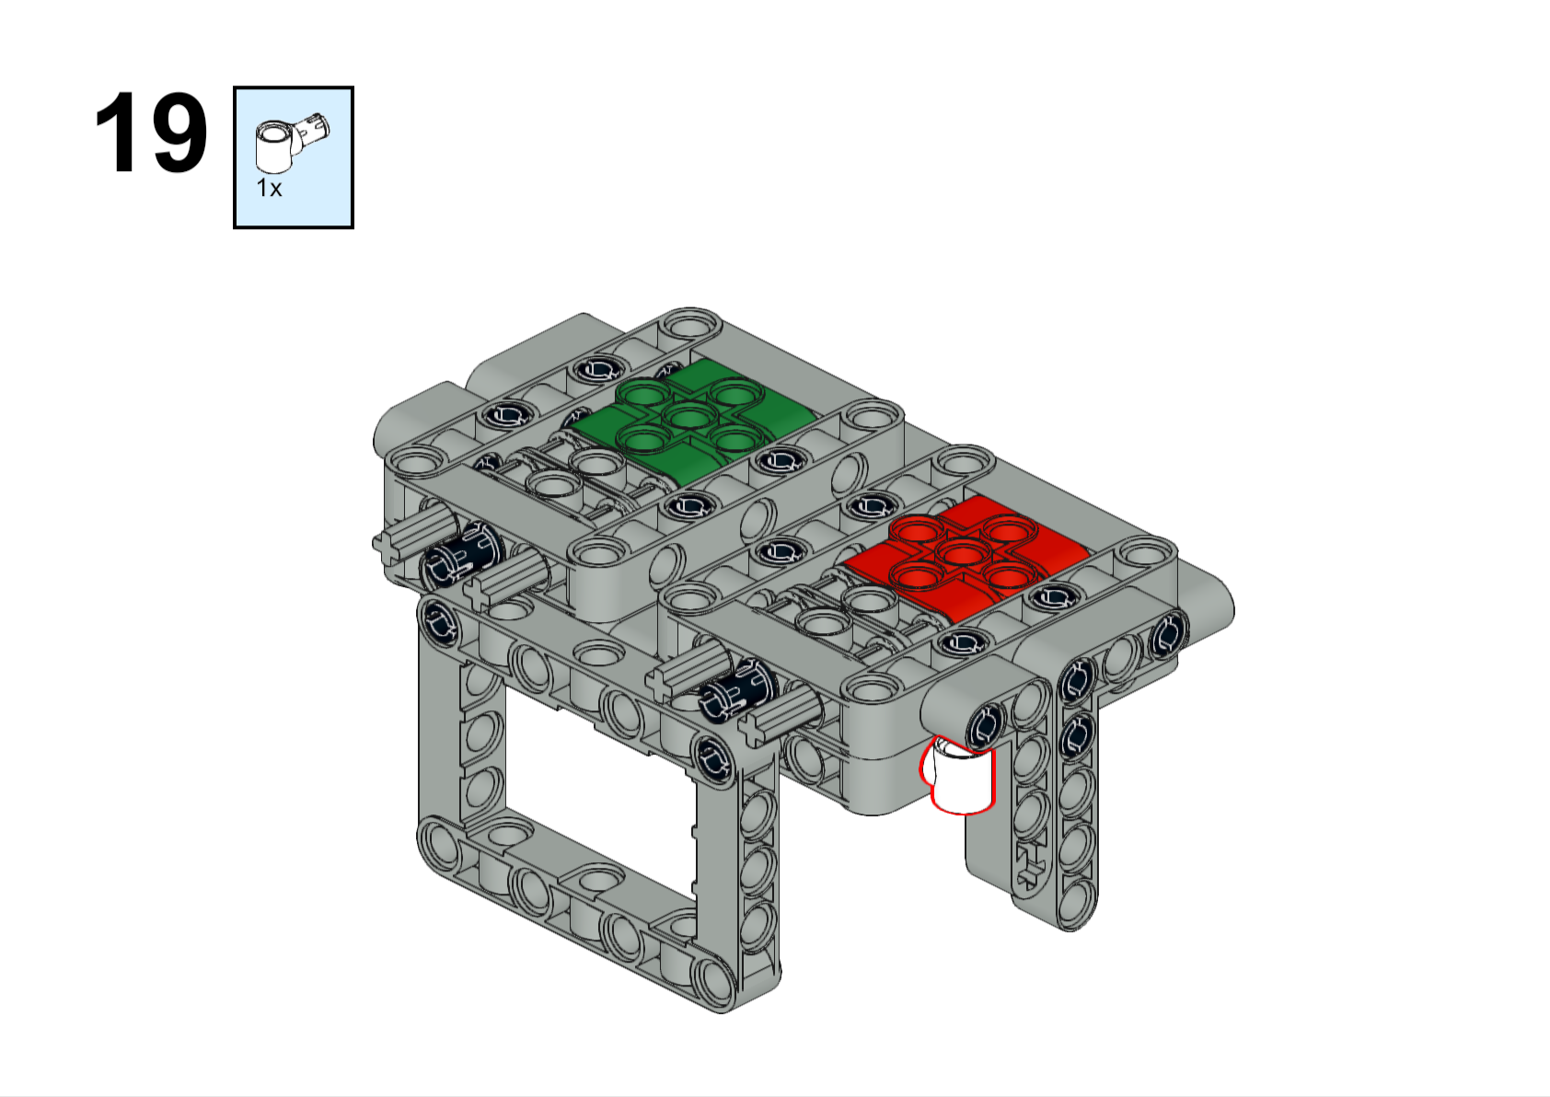
Forward

Slide 21
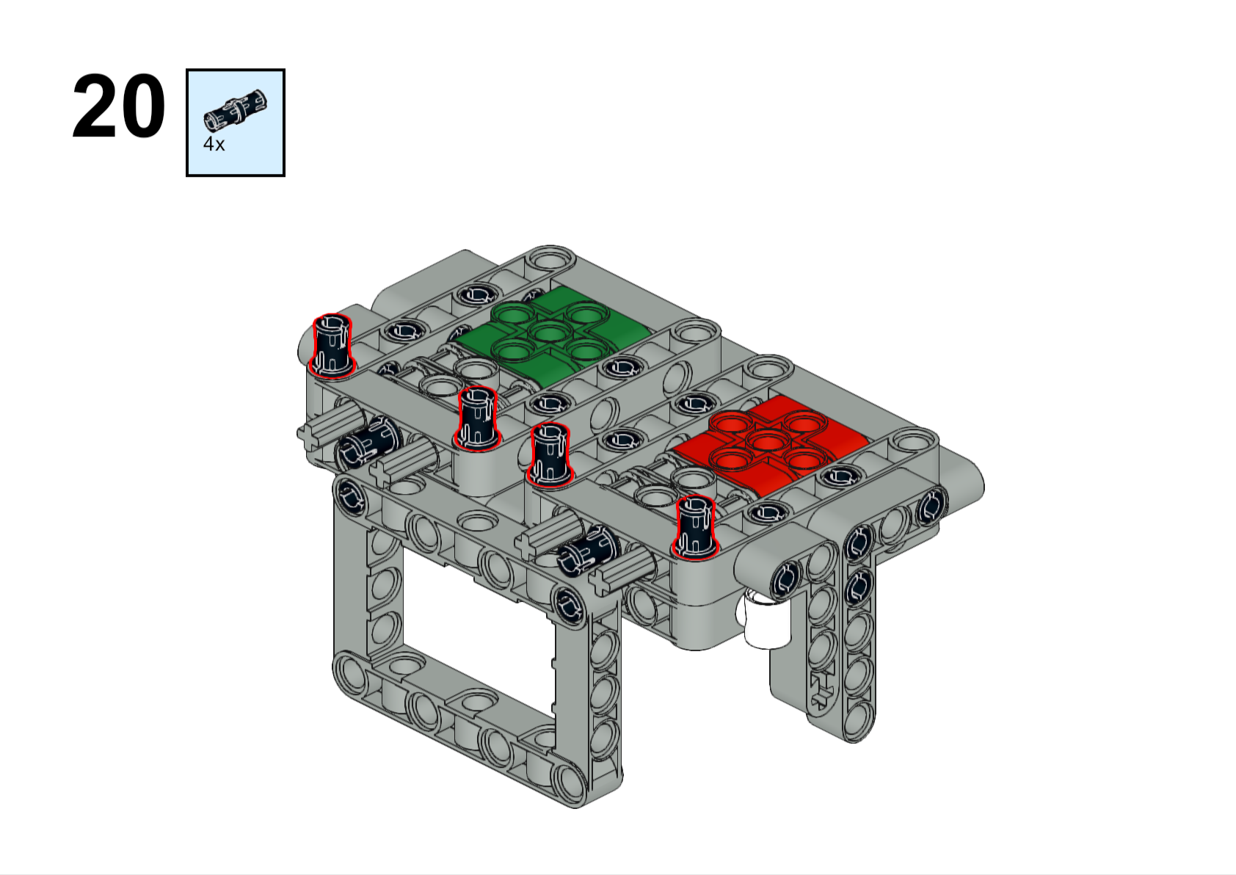
Forward

Slide 22
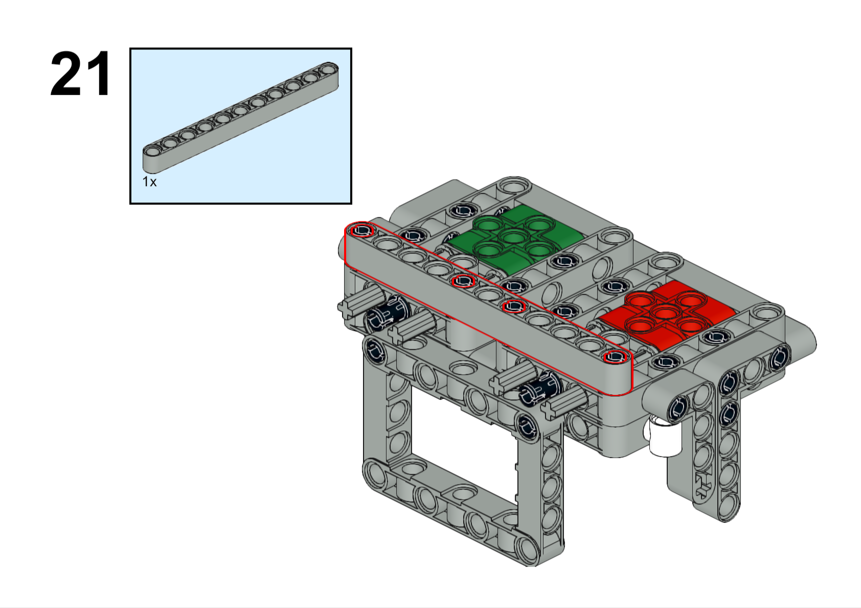
11L
Forward

Slide 23
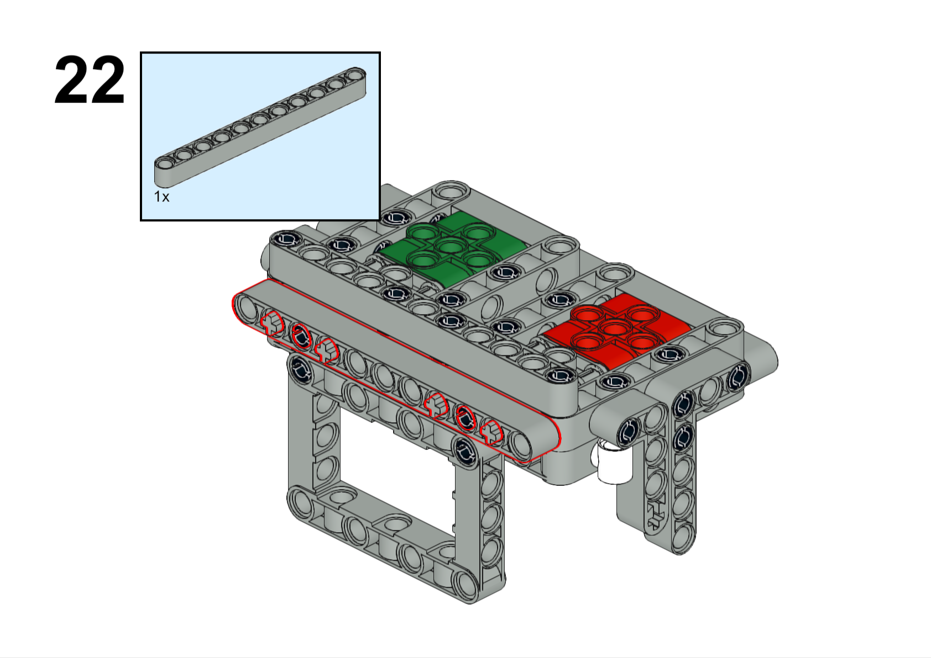
11L
Forward

Slide 24
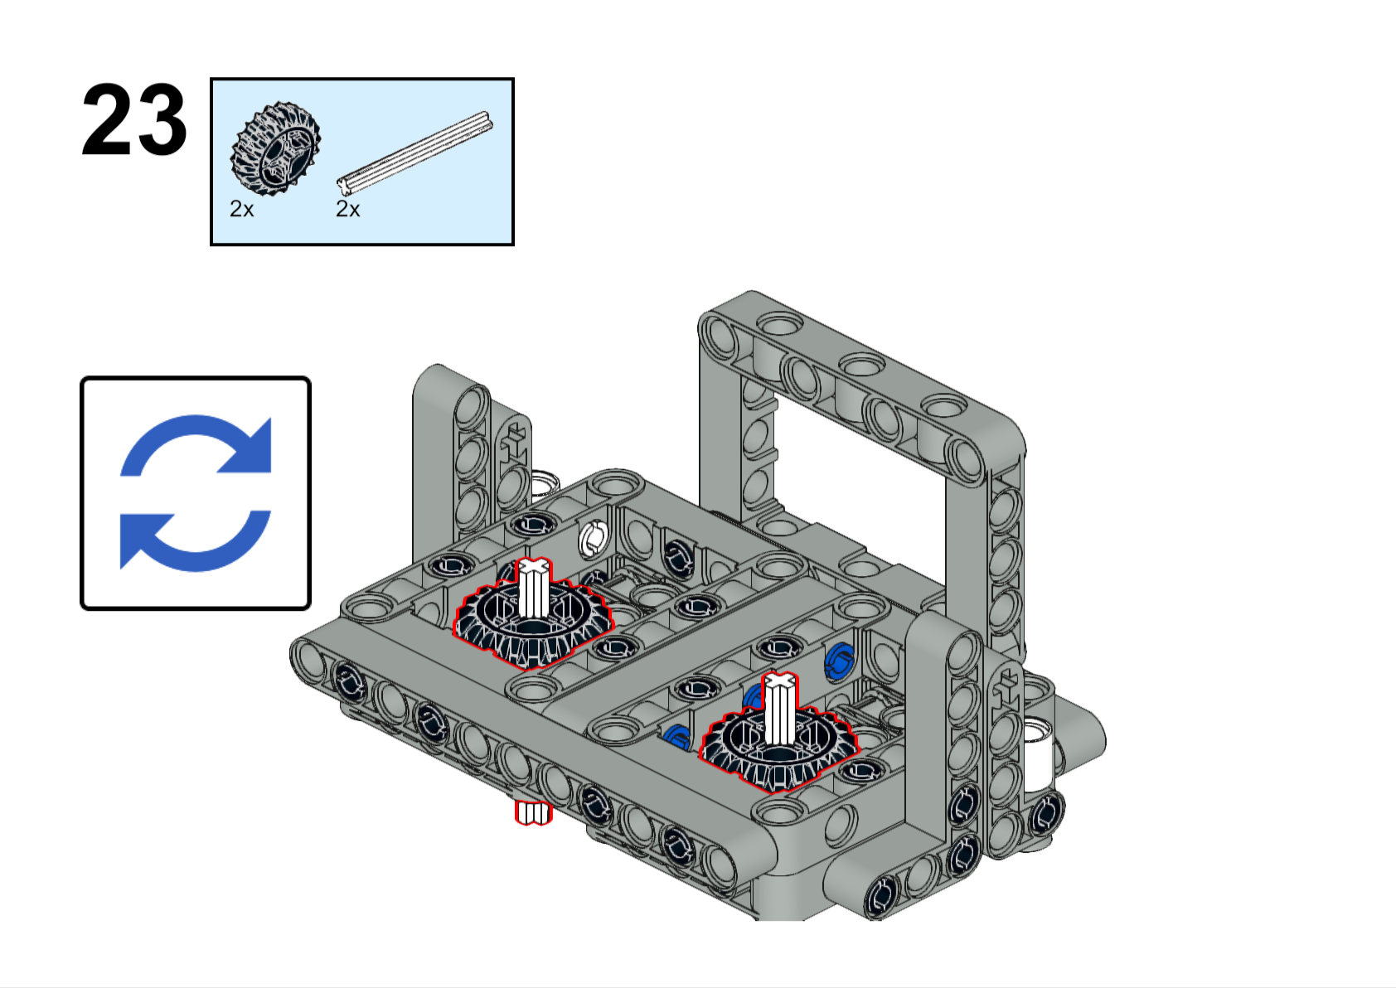
This is a gear and an axle. The axles will go through the center of the waffle (hard to see here, but the next page has a better picture).
5L
Turn the attachment upside-down
You will have to hold these in place until the next step (or next few steps) is/are complete

Slide 25
Axle Decision Time!
Remember the first slide where it talked about which way you want the axles pointed? Now is the time to make that decision. You can choose for each side to have an axle that points
Forward
Out to the left/right side
Straight up
No axle at all
Here we only show the forward pointing and left (or right)-pointing configuration.
If you need an axle pointing straight up on either side, you are basically done. Although you will probably need to adjust the axle length and use some bushings to keep the axle from falling.
If you aren’t sure which way you need your axles pointing, ask the coach.
Forward

Slide 26
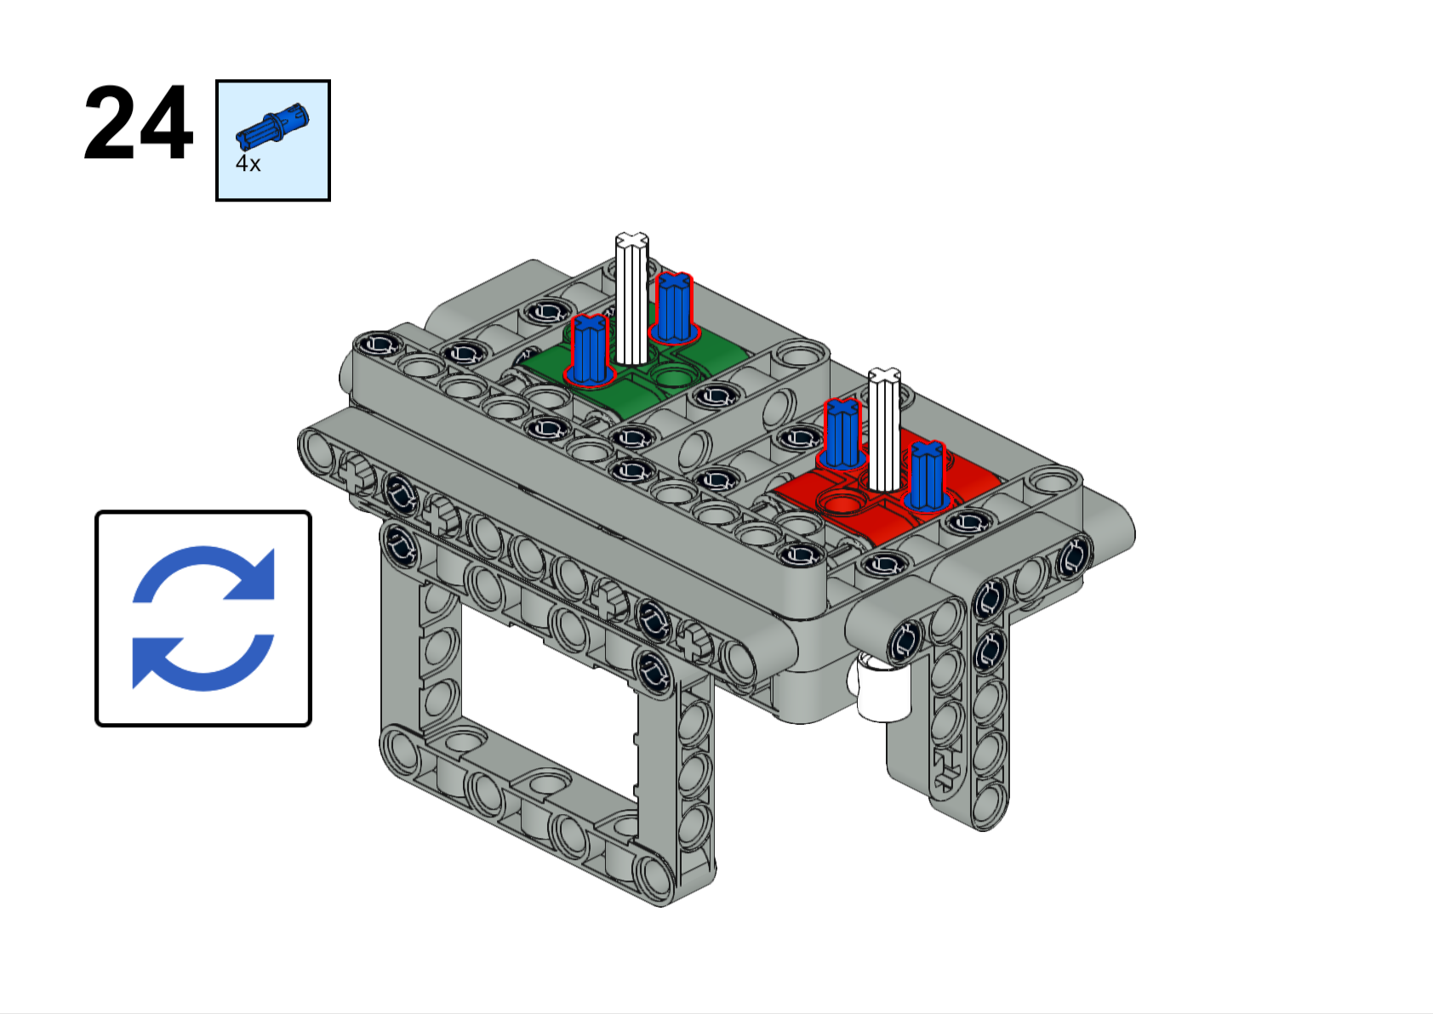
We call these “short blue pegs”. See how it has one end like an axle, and the other end is just like the black pegs. Yes, there is a “long blue peg”. You used them on the very first step.
Here we are going to have an axle that points out the front
Right side
Left side
Here we are going to have an axle that points out the left side
Forward

Slide 27
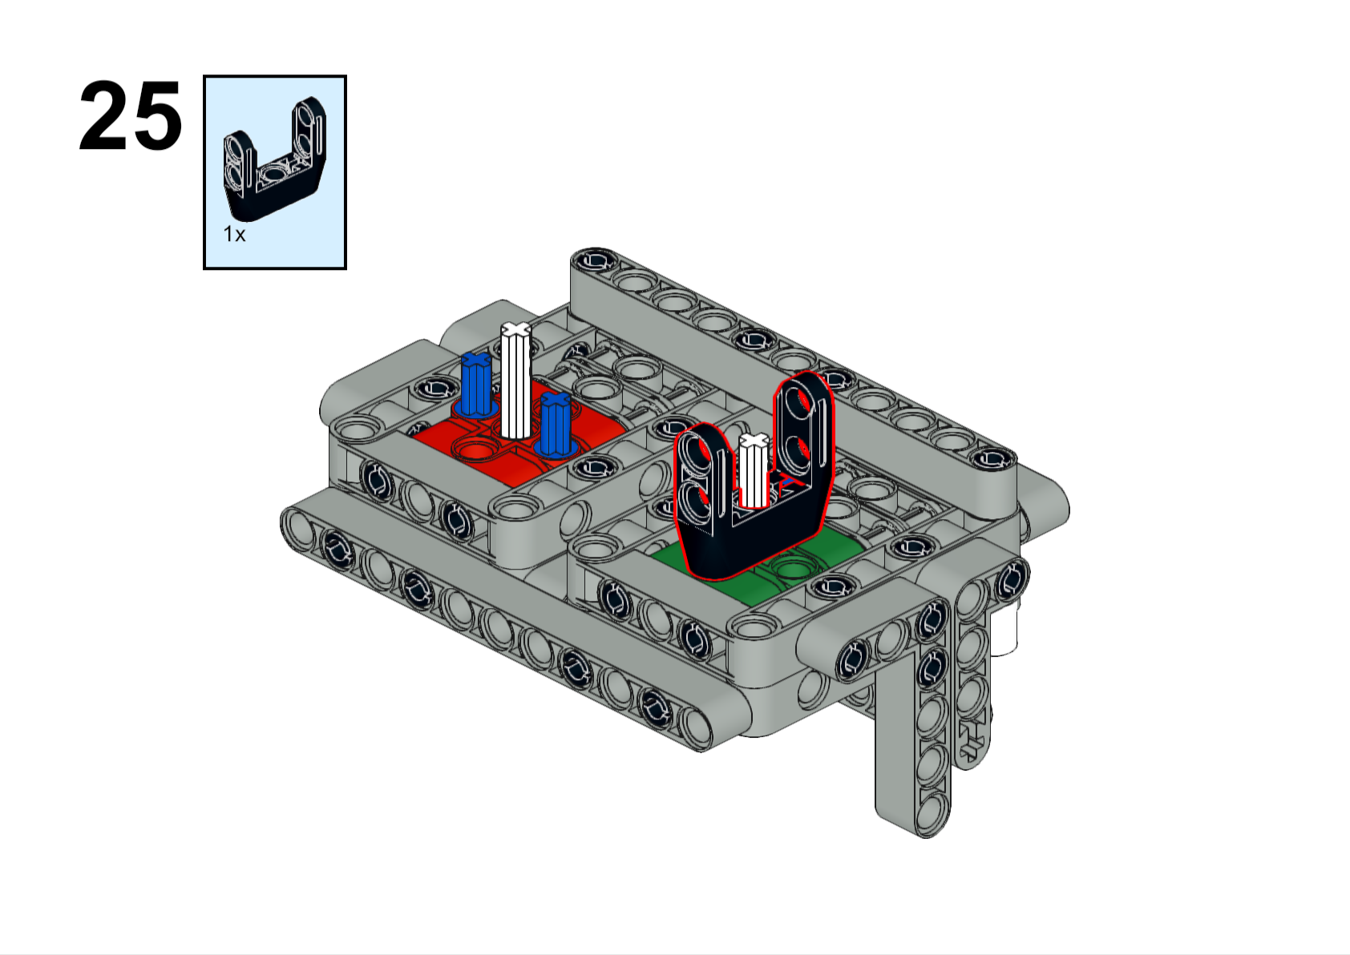
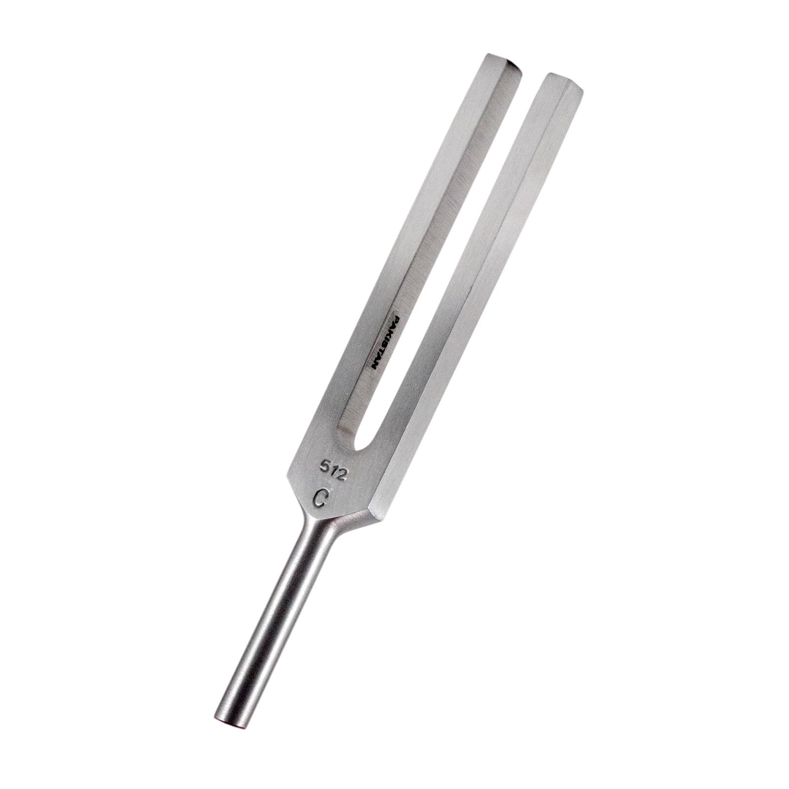
Some people call these “forks” because they look like a tuning fork
Forward

Slide 28
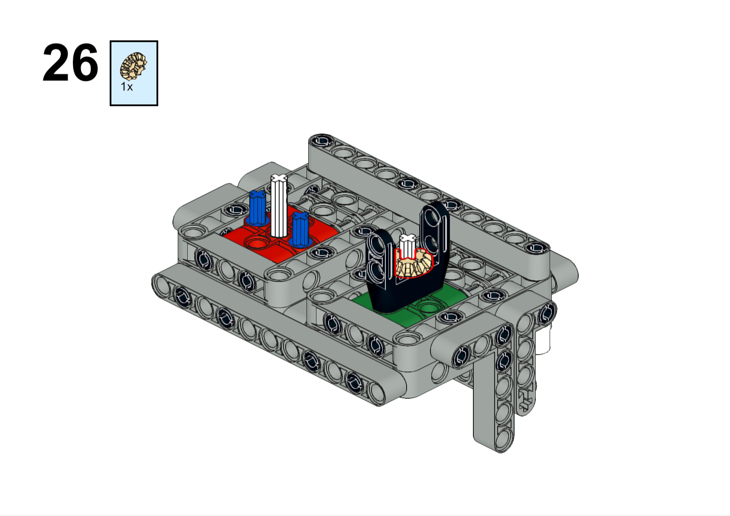
This is called a “bevel gear” and it is used to make gears at right angles.
Forward

Slide 29
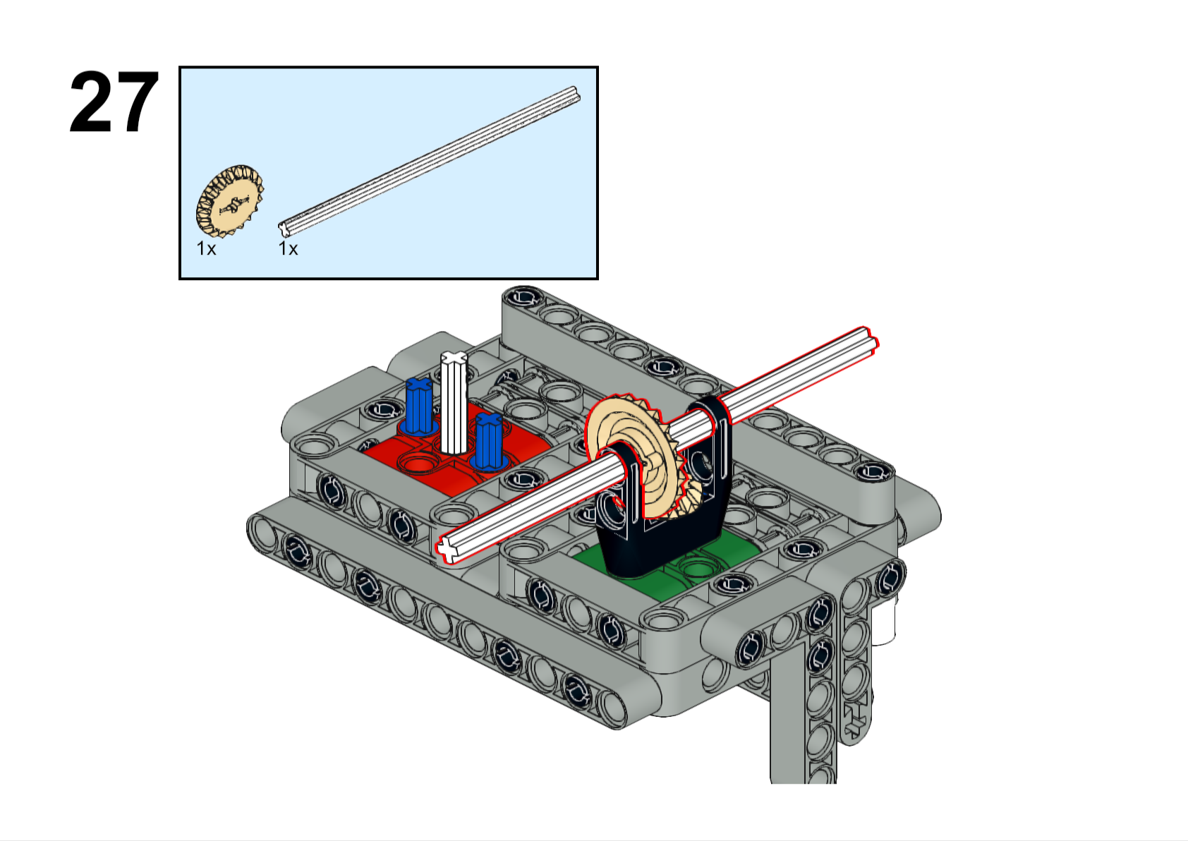
Adjust the axle length to whatever you need. Use bushings to hold everything in place.
??L
Forward

Slide 30
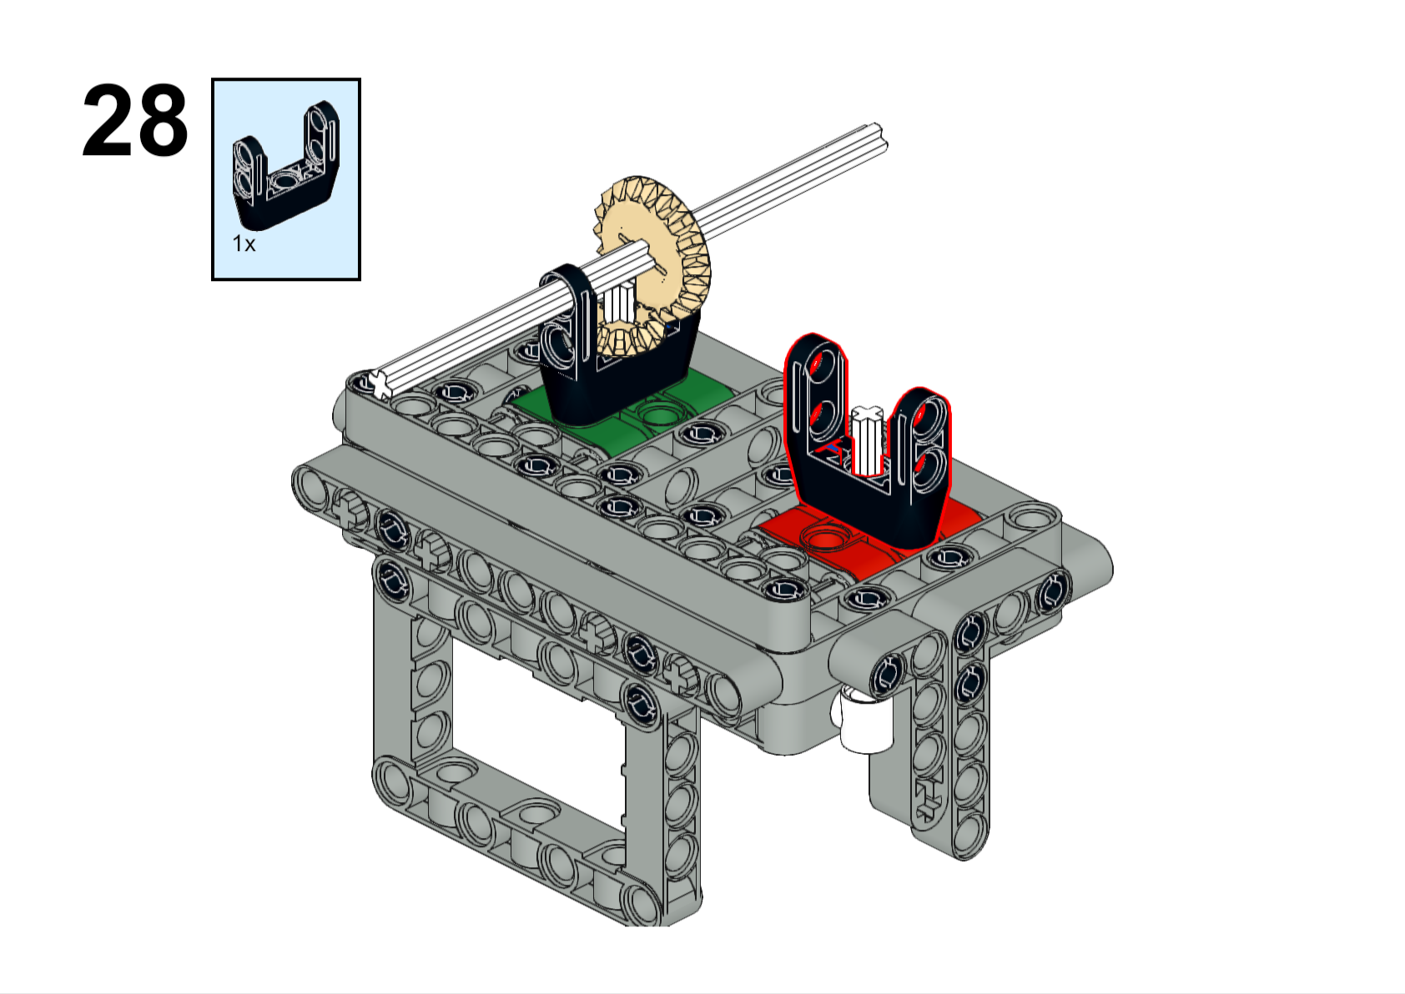
Forward

Slide 31
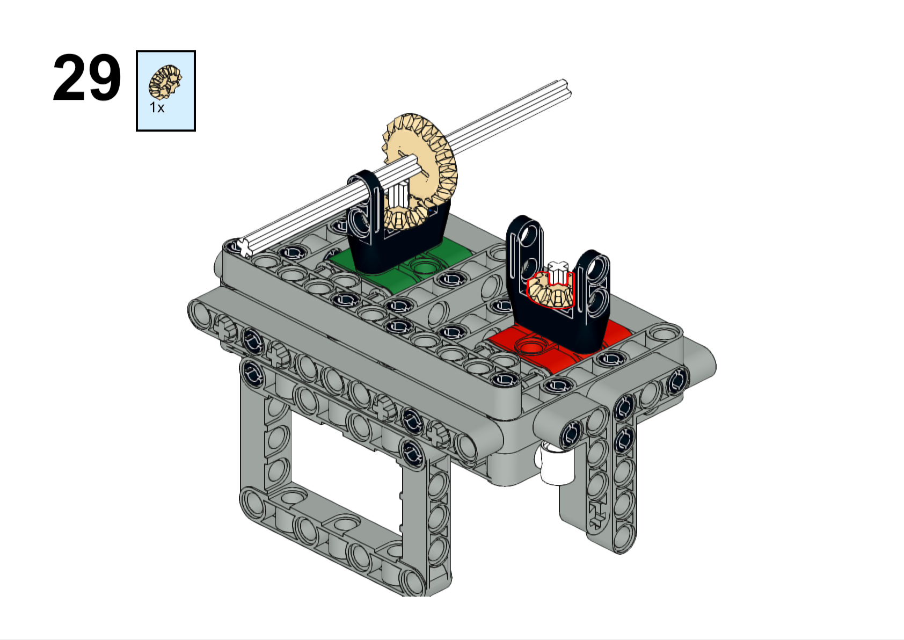

Slide 32
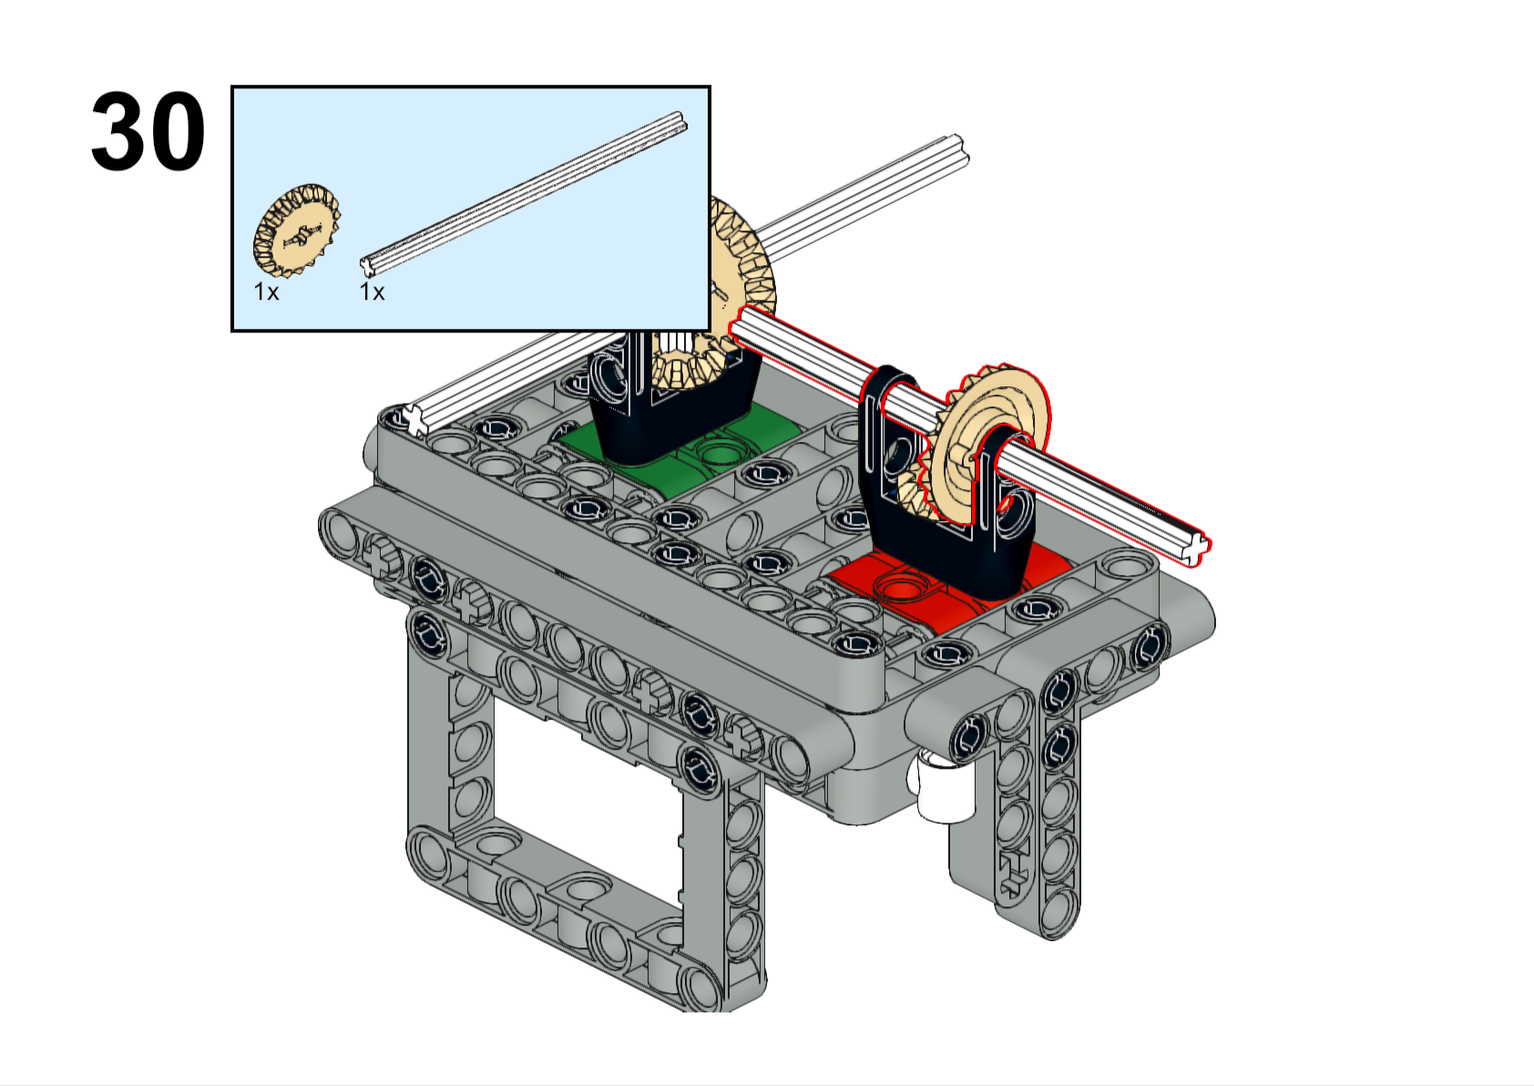
??L
Adjust the axle length to whatever you need. Use bushings to hold everything in place.
Right side
Left side
Forward

Slide 33
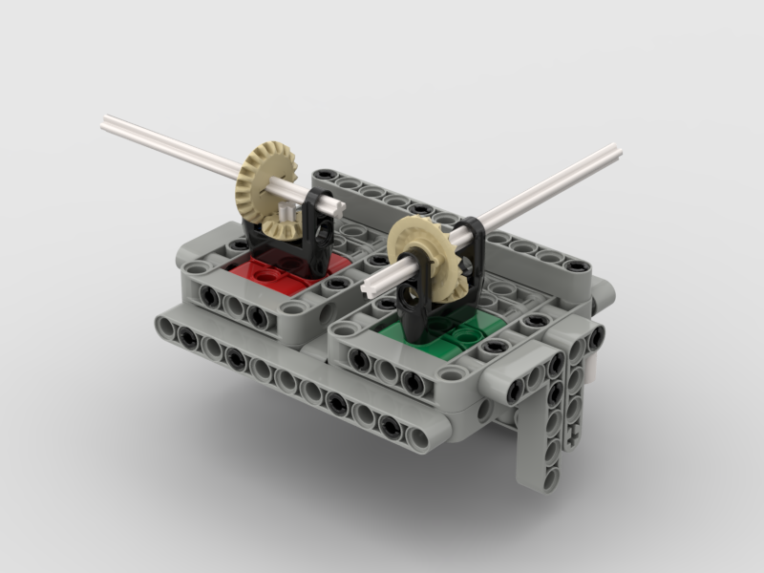
At this point you are pretty much done! Done with the “base attachment”, anyway. But now you need to figure out how to make your attachment do the thing that you need it to do. Maybe you need some arms on the axles. Or a claw? Or a grabber of some sort. That is all up to you. Brainstorm, ask your teammates, or ask a coach if you need help.
And remember, robots NEVER work perfectly the first time. Your design will almost definitely need changes, but don’t worry about that! In fact, that is what makes it FUN!

Slide 34
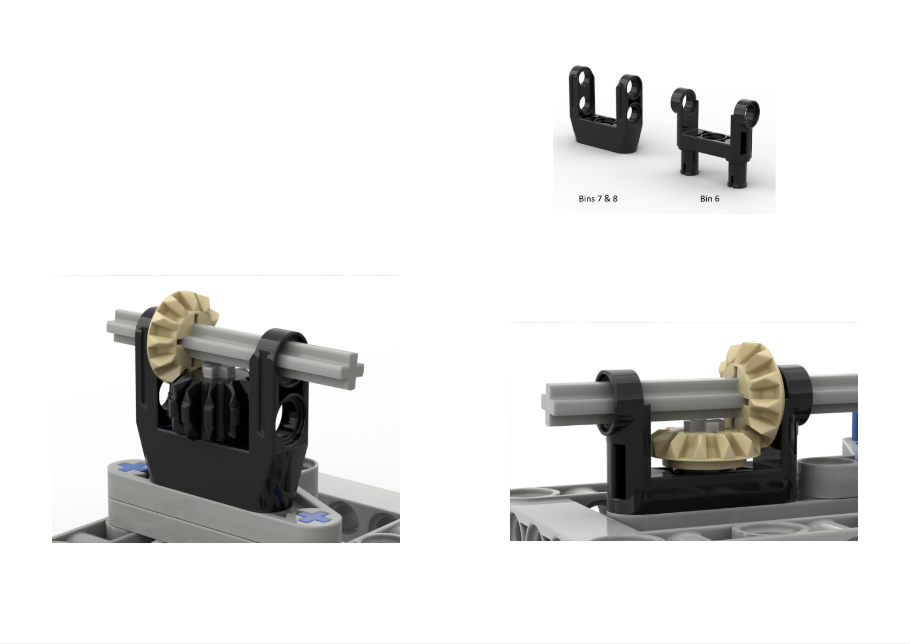
There are some other ways to configure your attachment. For example, these attachments will go faster because they have a higher “gear ratio”.

Slide 35
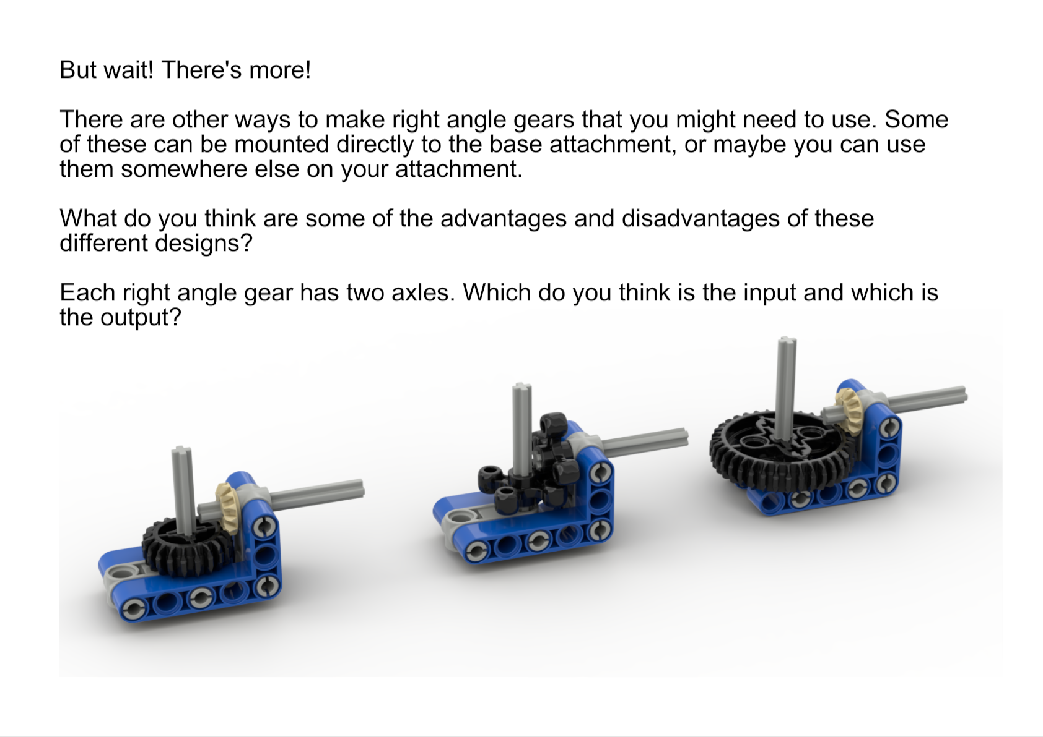

Slide 36
